Slide 1
See what you can do with PowerPoint Designer & Pickit Free Images
SAMPLE PRESENTATION
Activate Design Ideas for options

Slide 2
“Let the dataset change your mindset.”
Hans Rosling

Slide 3
“The first way to think about the future is to know about the present.”
Hans Rosling

Slide 4
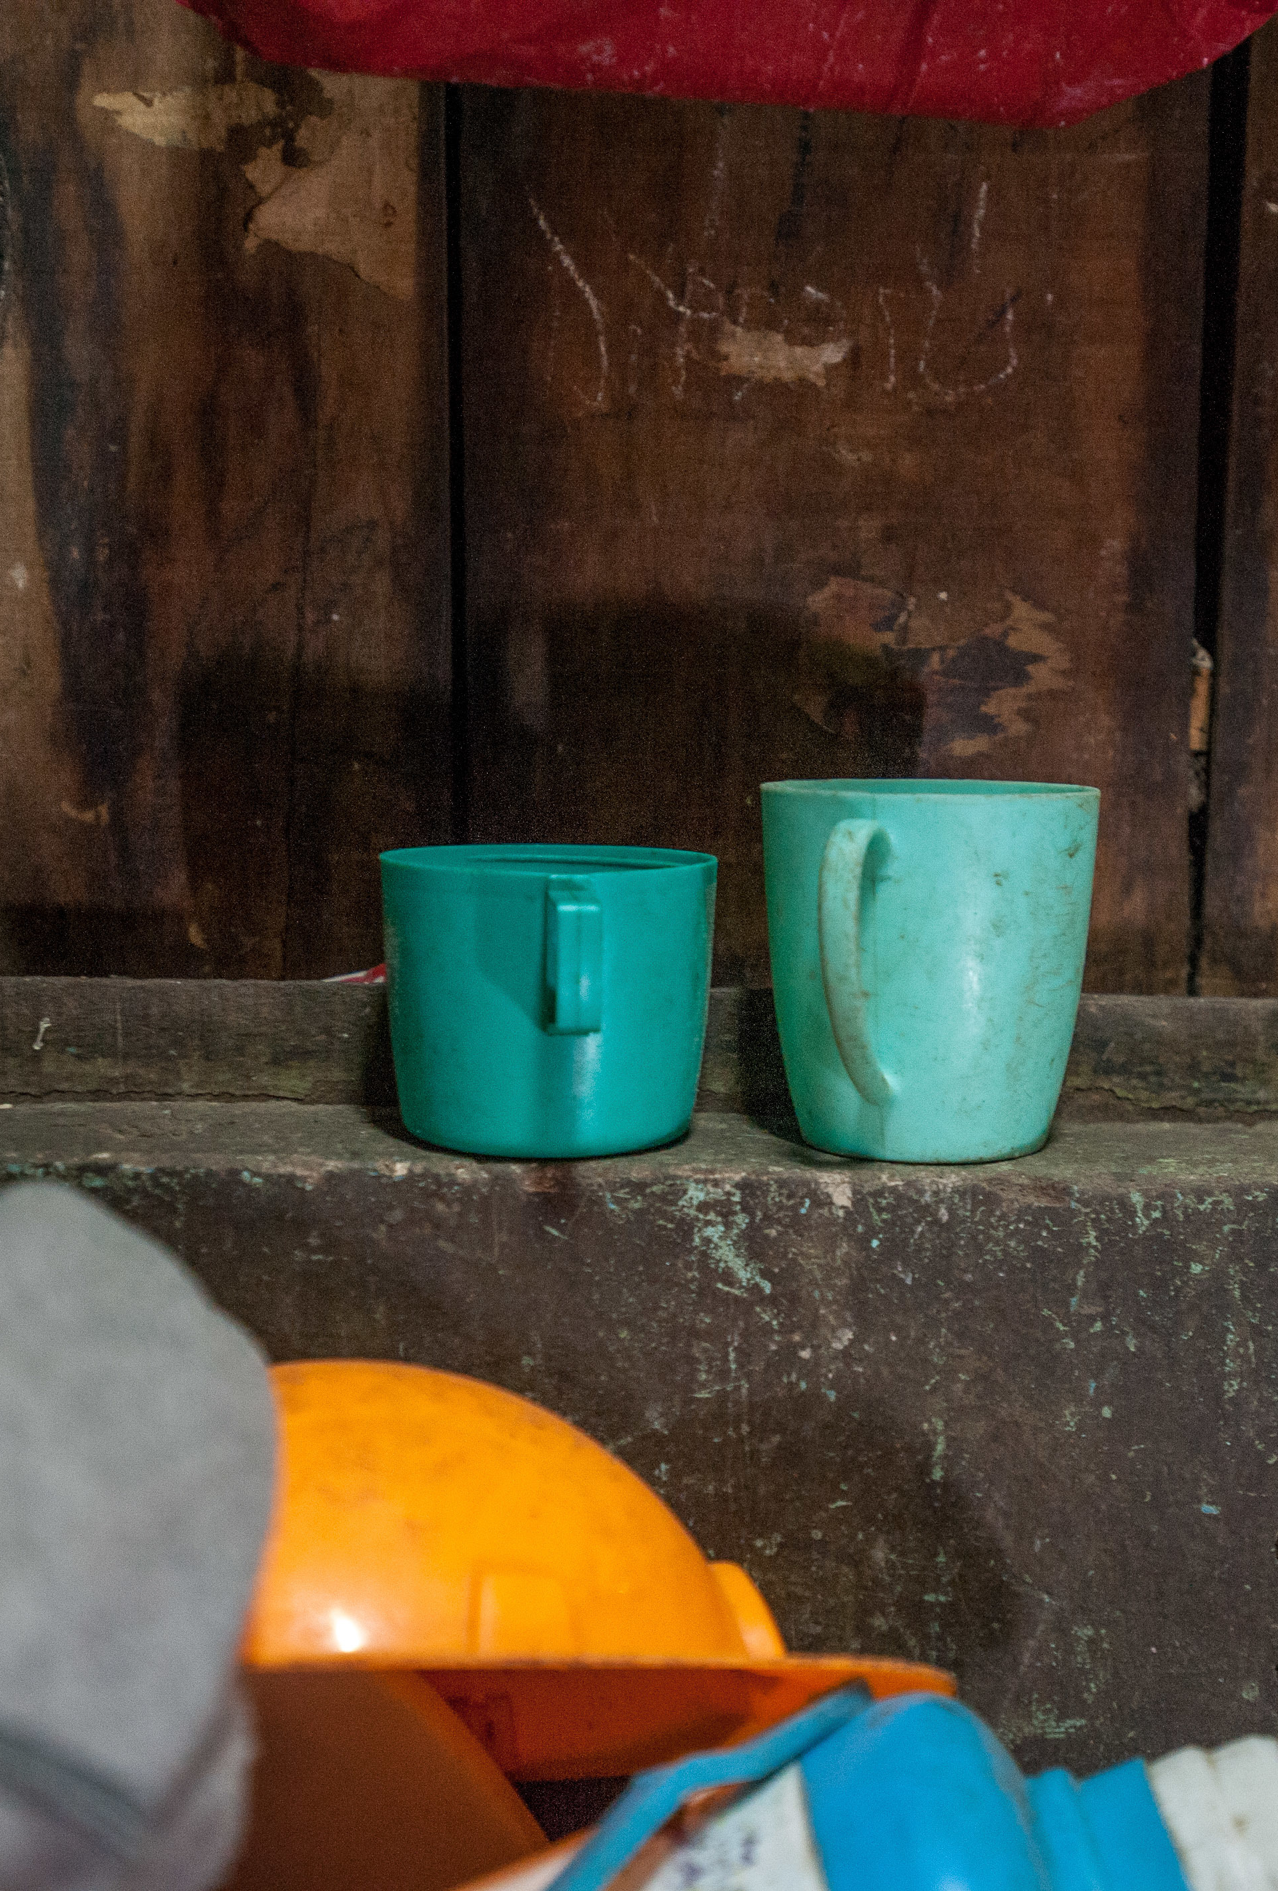
“The idea is to go from numbers to information to understanding.”
Hans Rosling

Slide 5
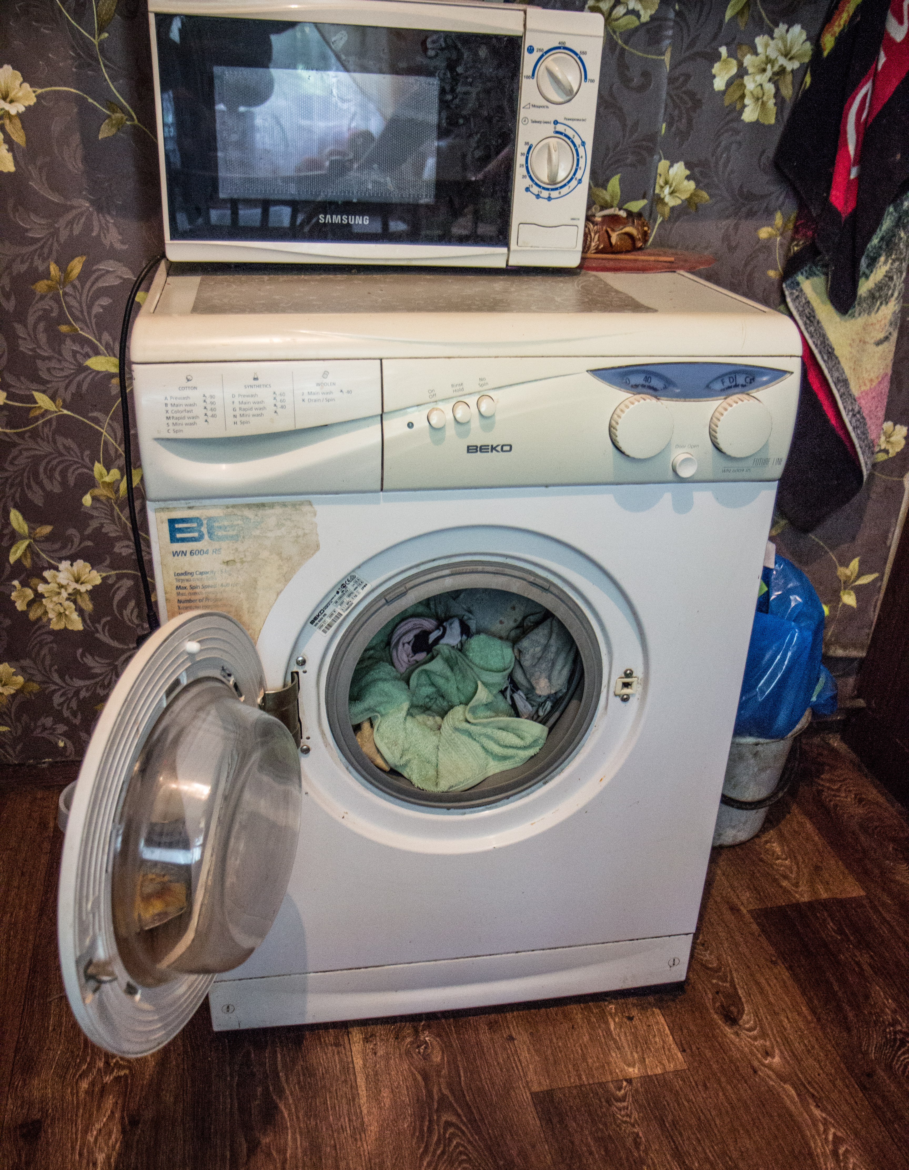
“If you have democracy, people will vote for washing machines. They love them!”
Hans Rosling

Slide 6
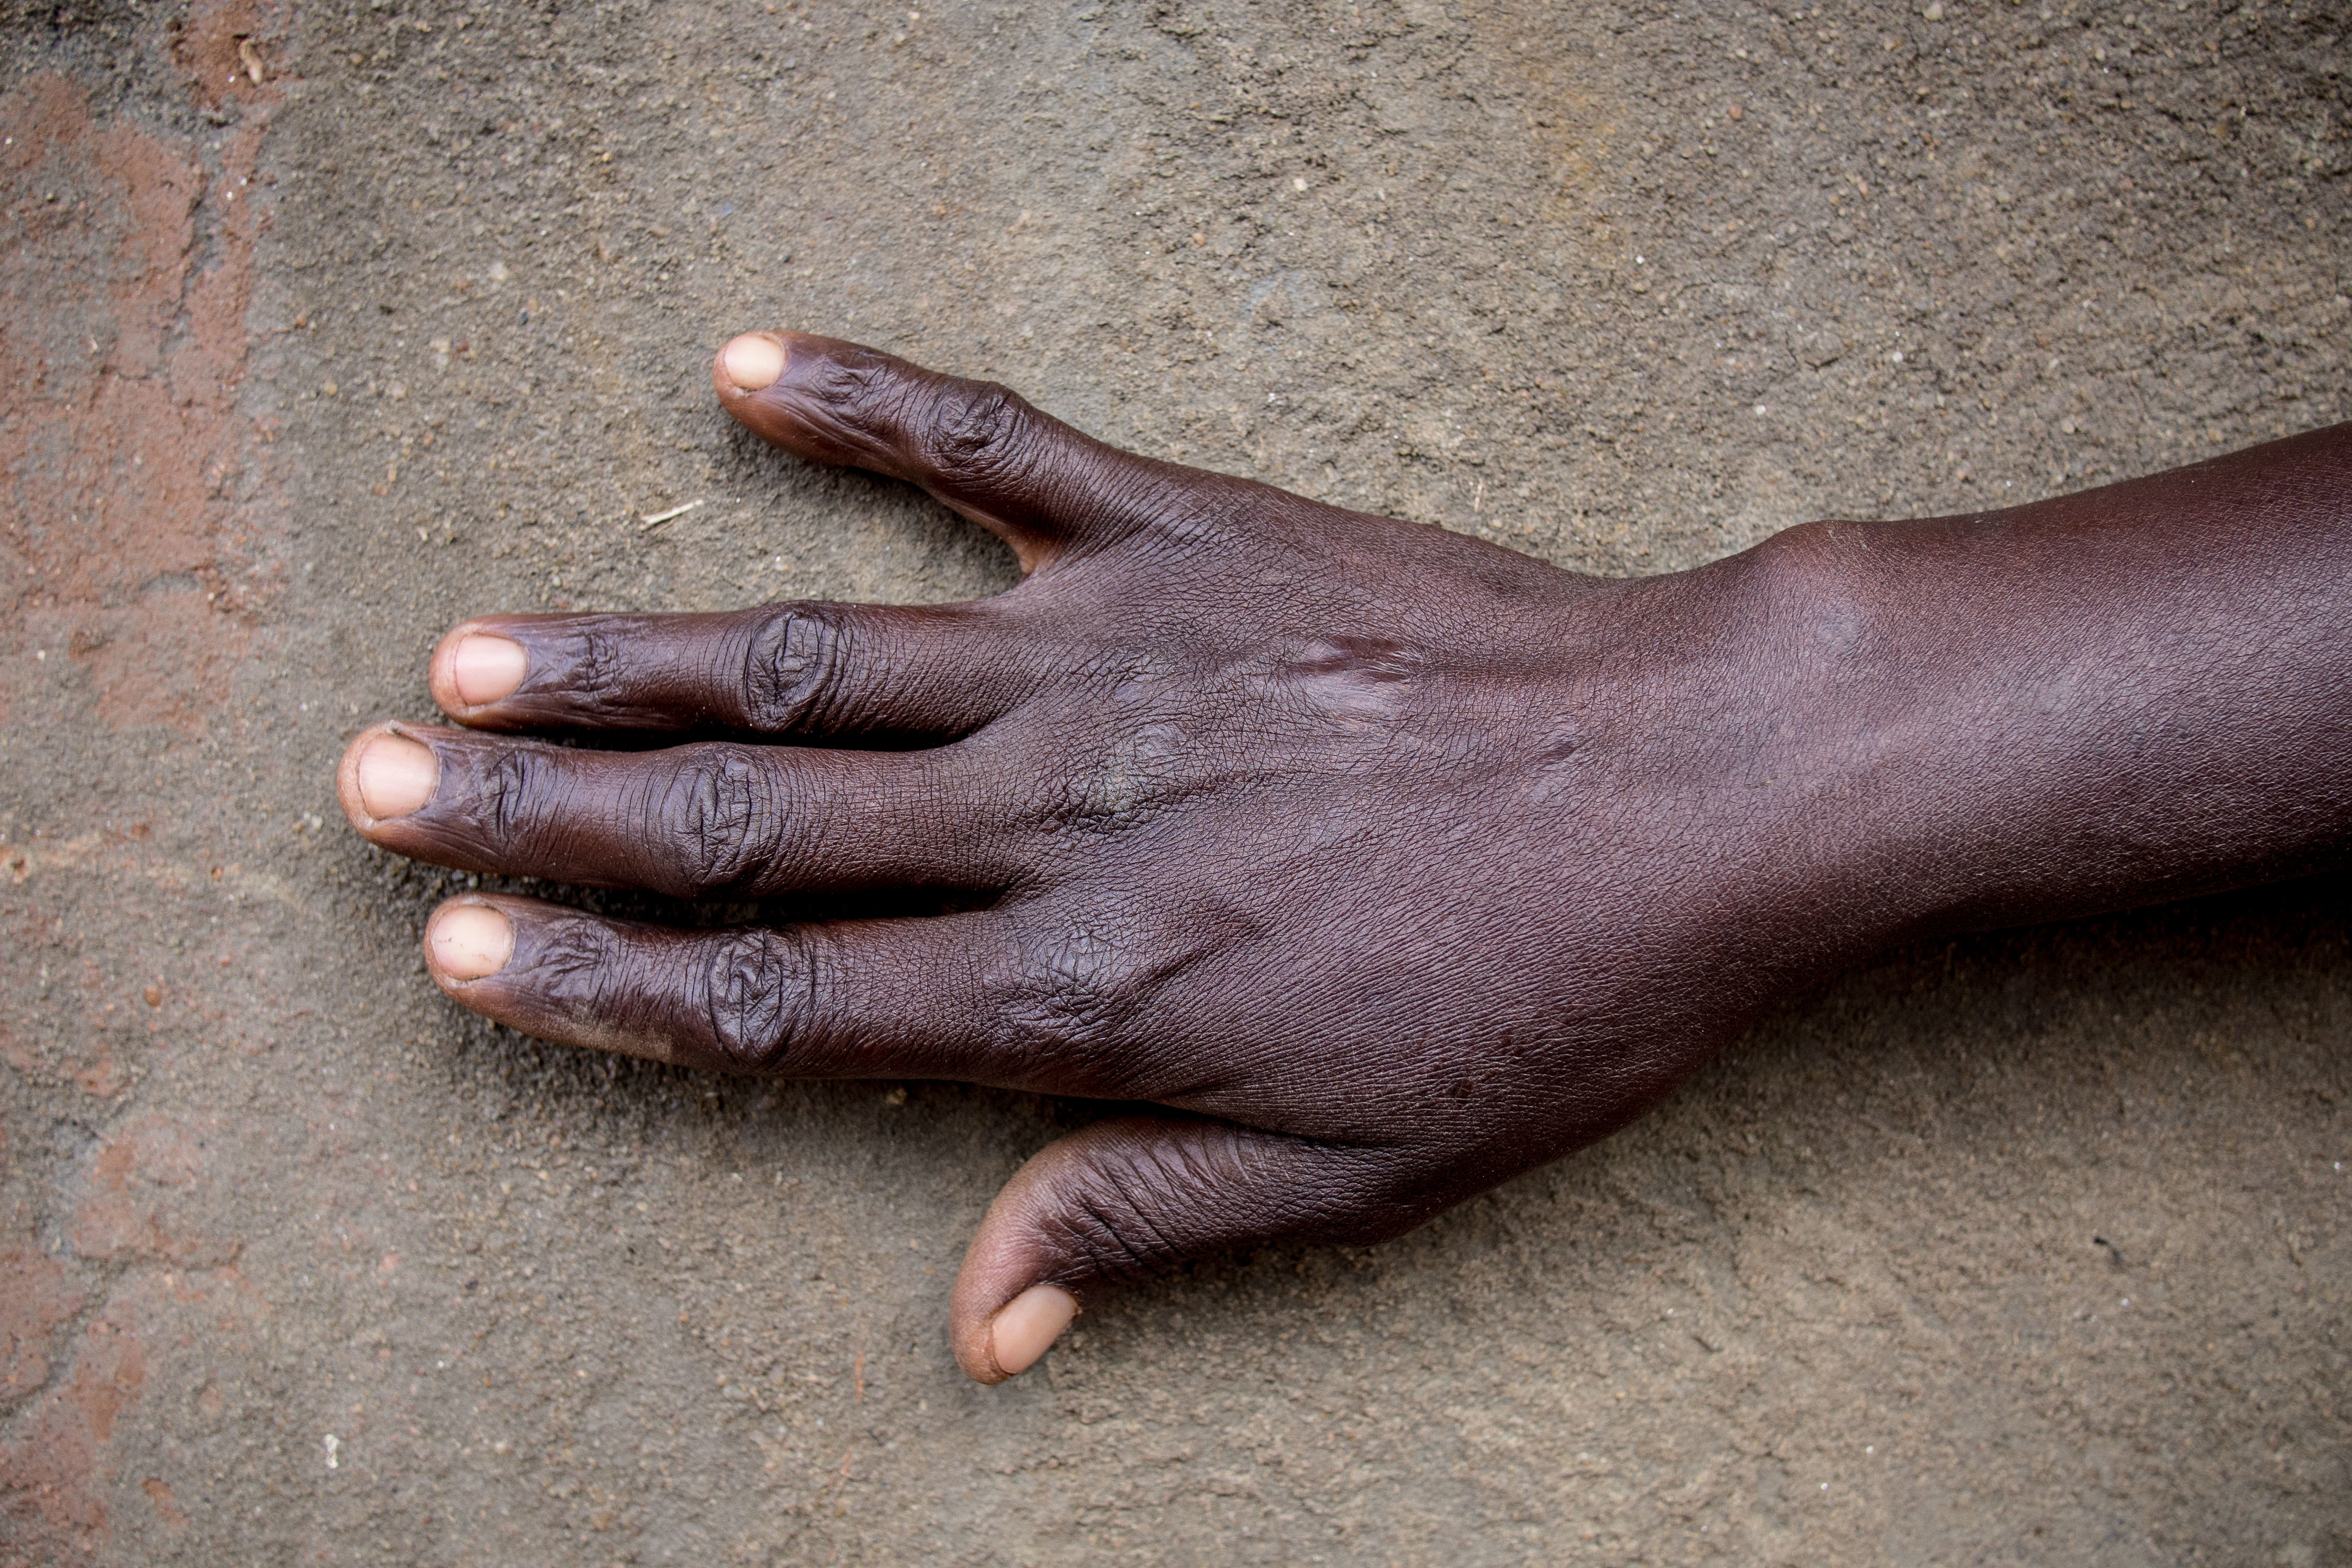
“One of the greatest challenges we face is overcoming bias.”
Ola Rosling

Slide 7
“The first way to think about the future is to know about the present.”
Hans Rosling

