Slide 1
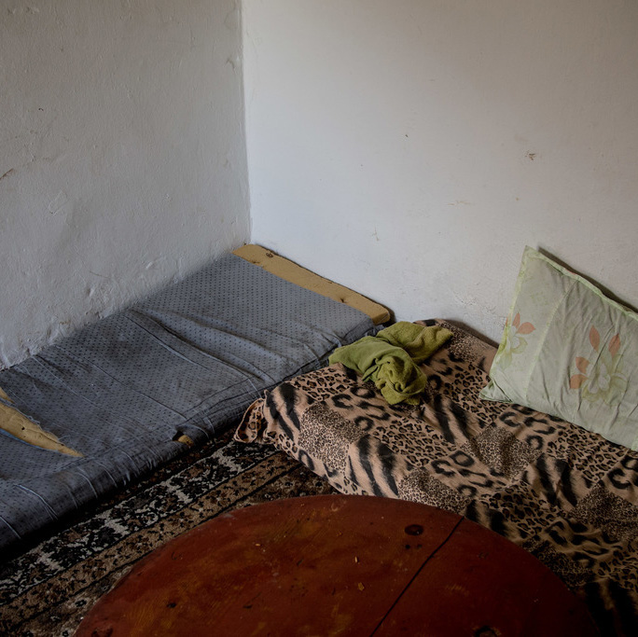
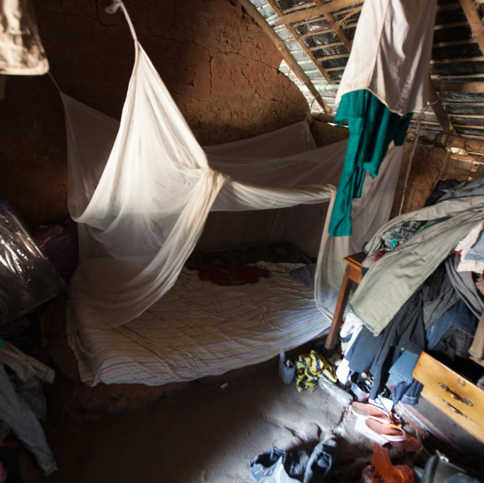
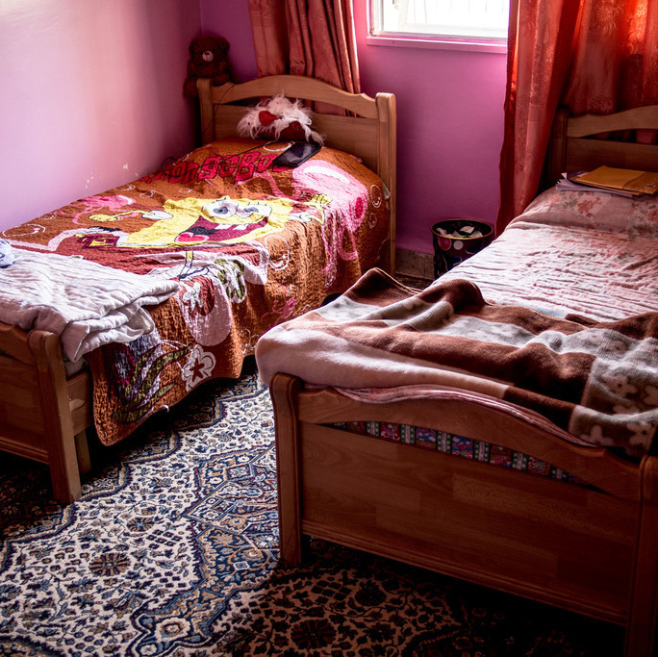
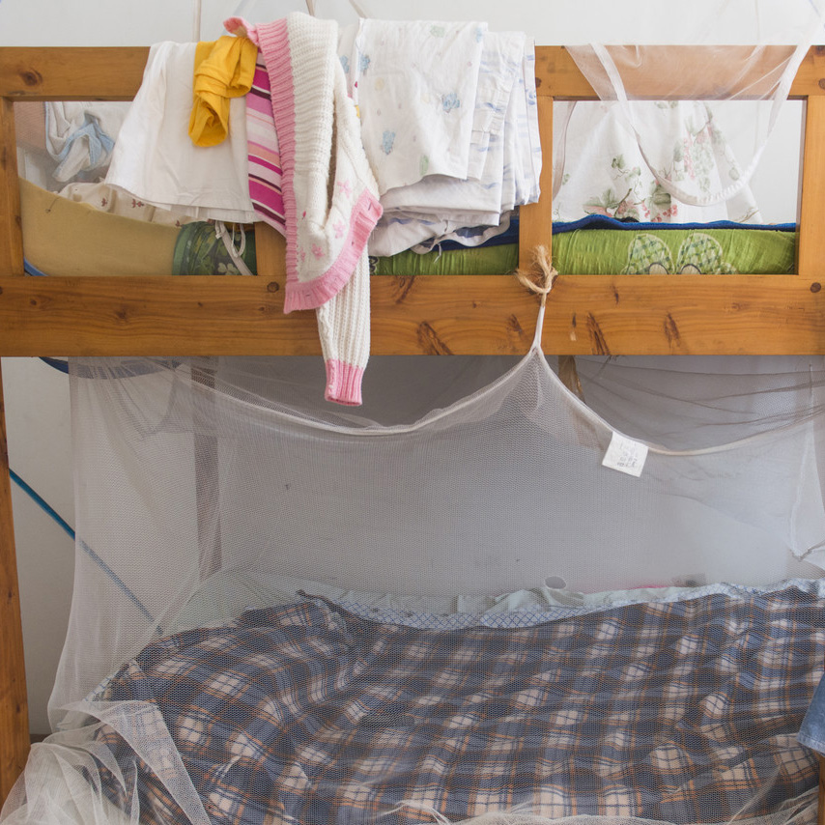
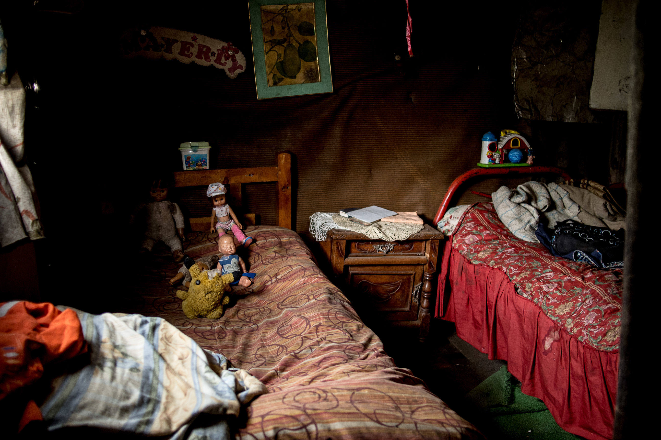
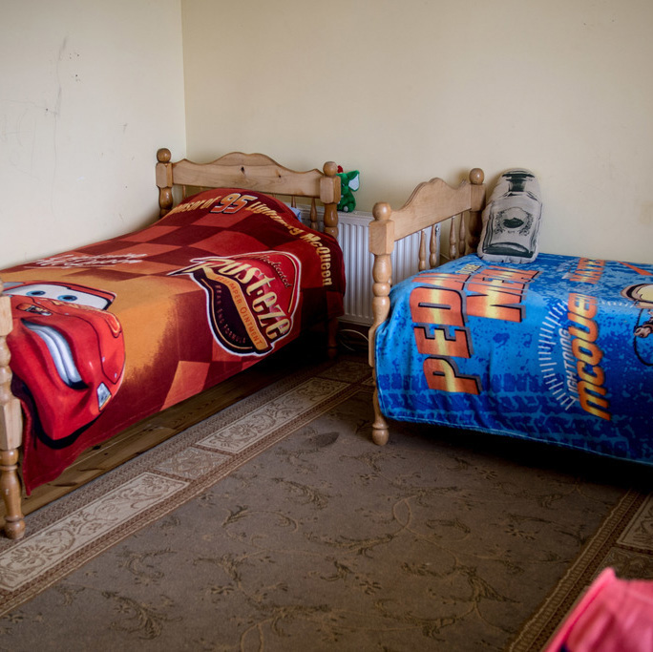
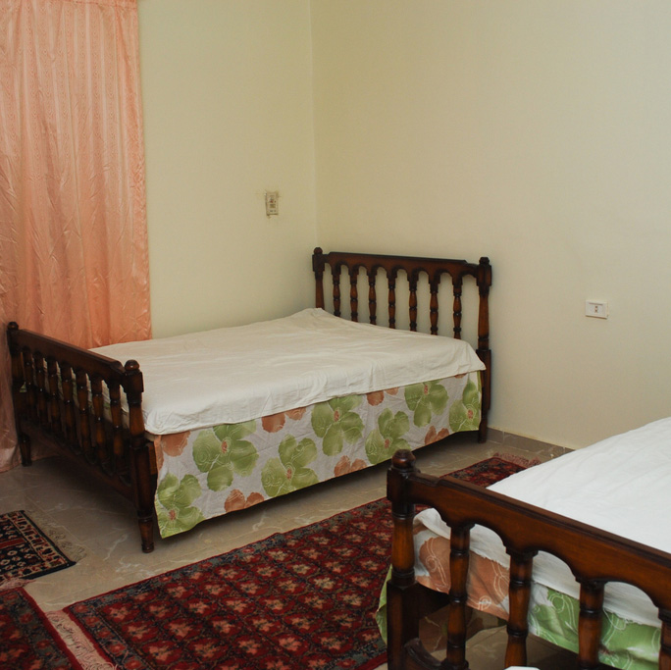
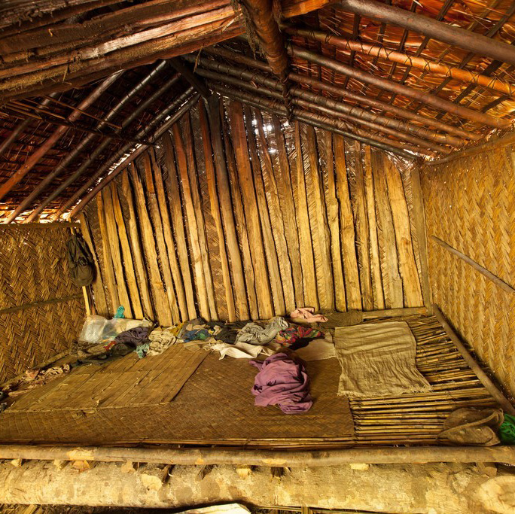
“
All over the world, two child families are the norm, not the exception.
- Hans Rosling

Slide 2
“
All over the world, two child families are the norm, not the exception.
- Hans Rosling

Slide 3
“
All over the world, two child families are the norm, not the exception.
- Hans Rosling

Slide 4
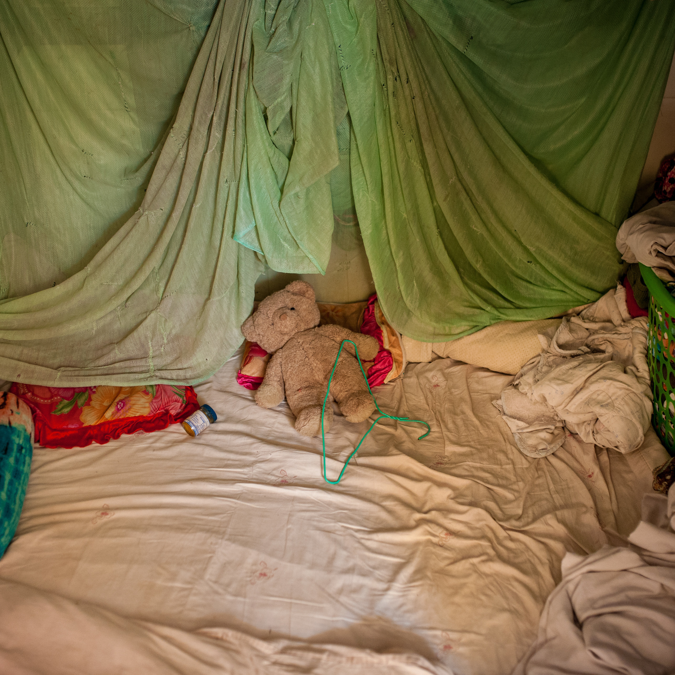
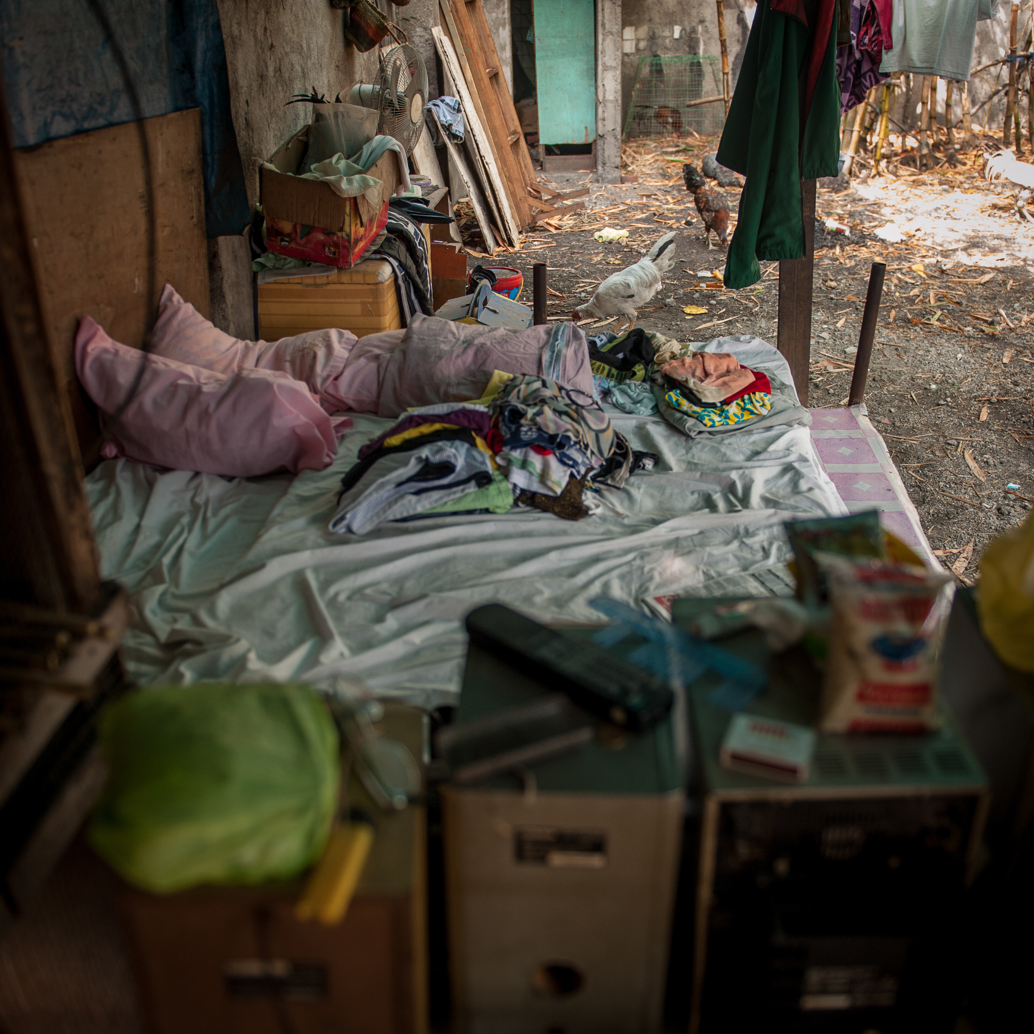
“
All over the world, two child families are the norm, not the exception.
”
- Hans Rosling

Slide 5
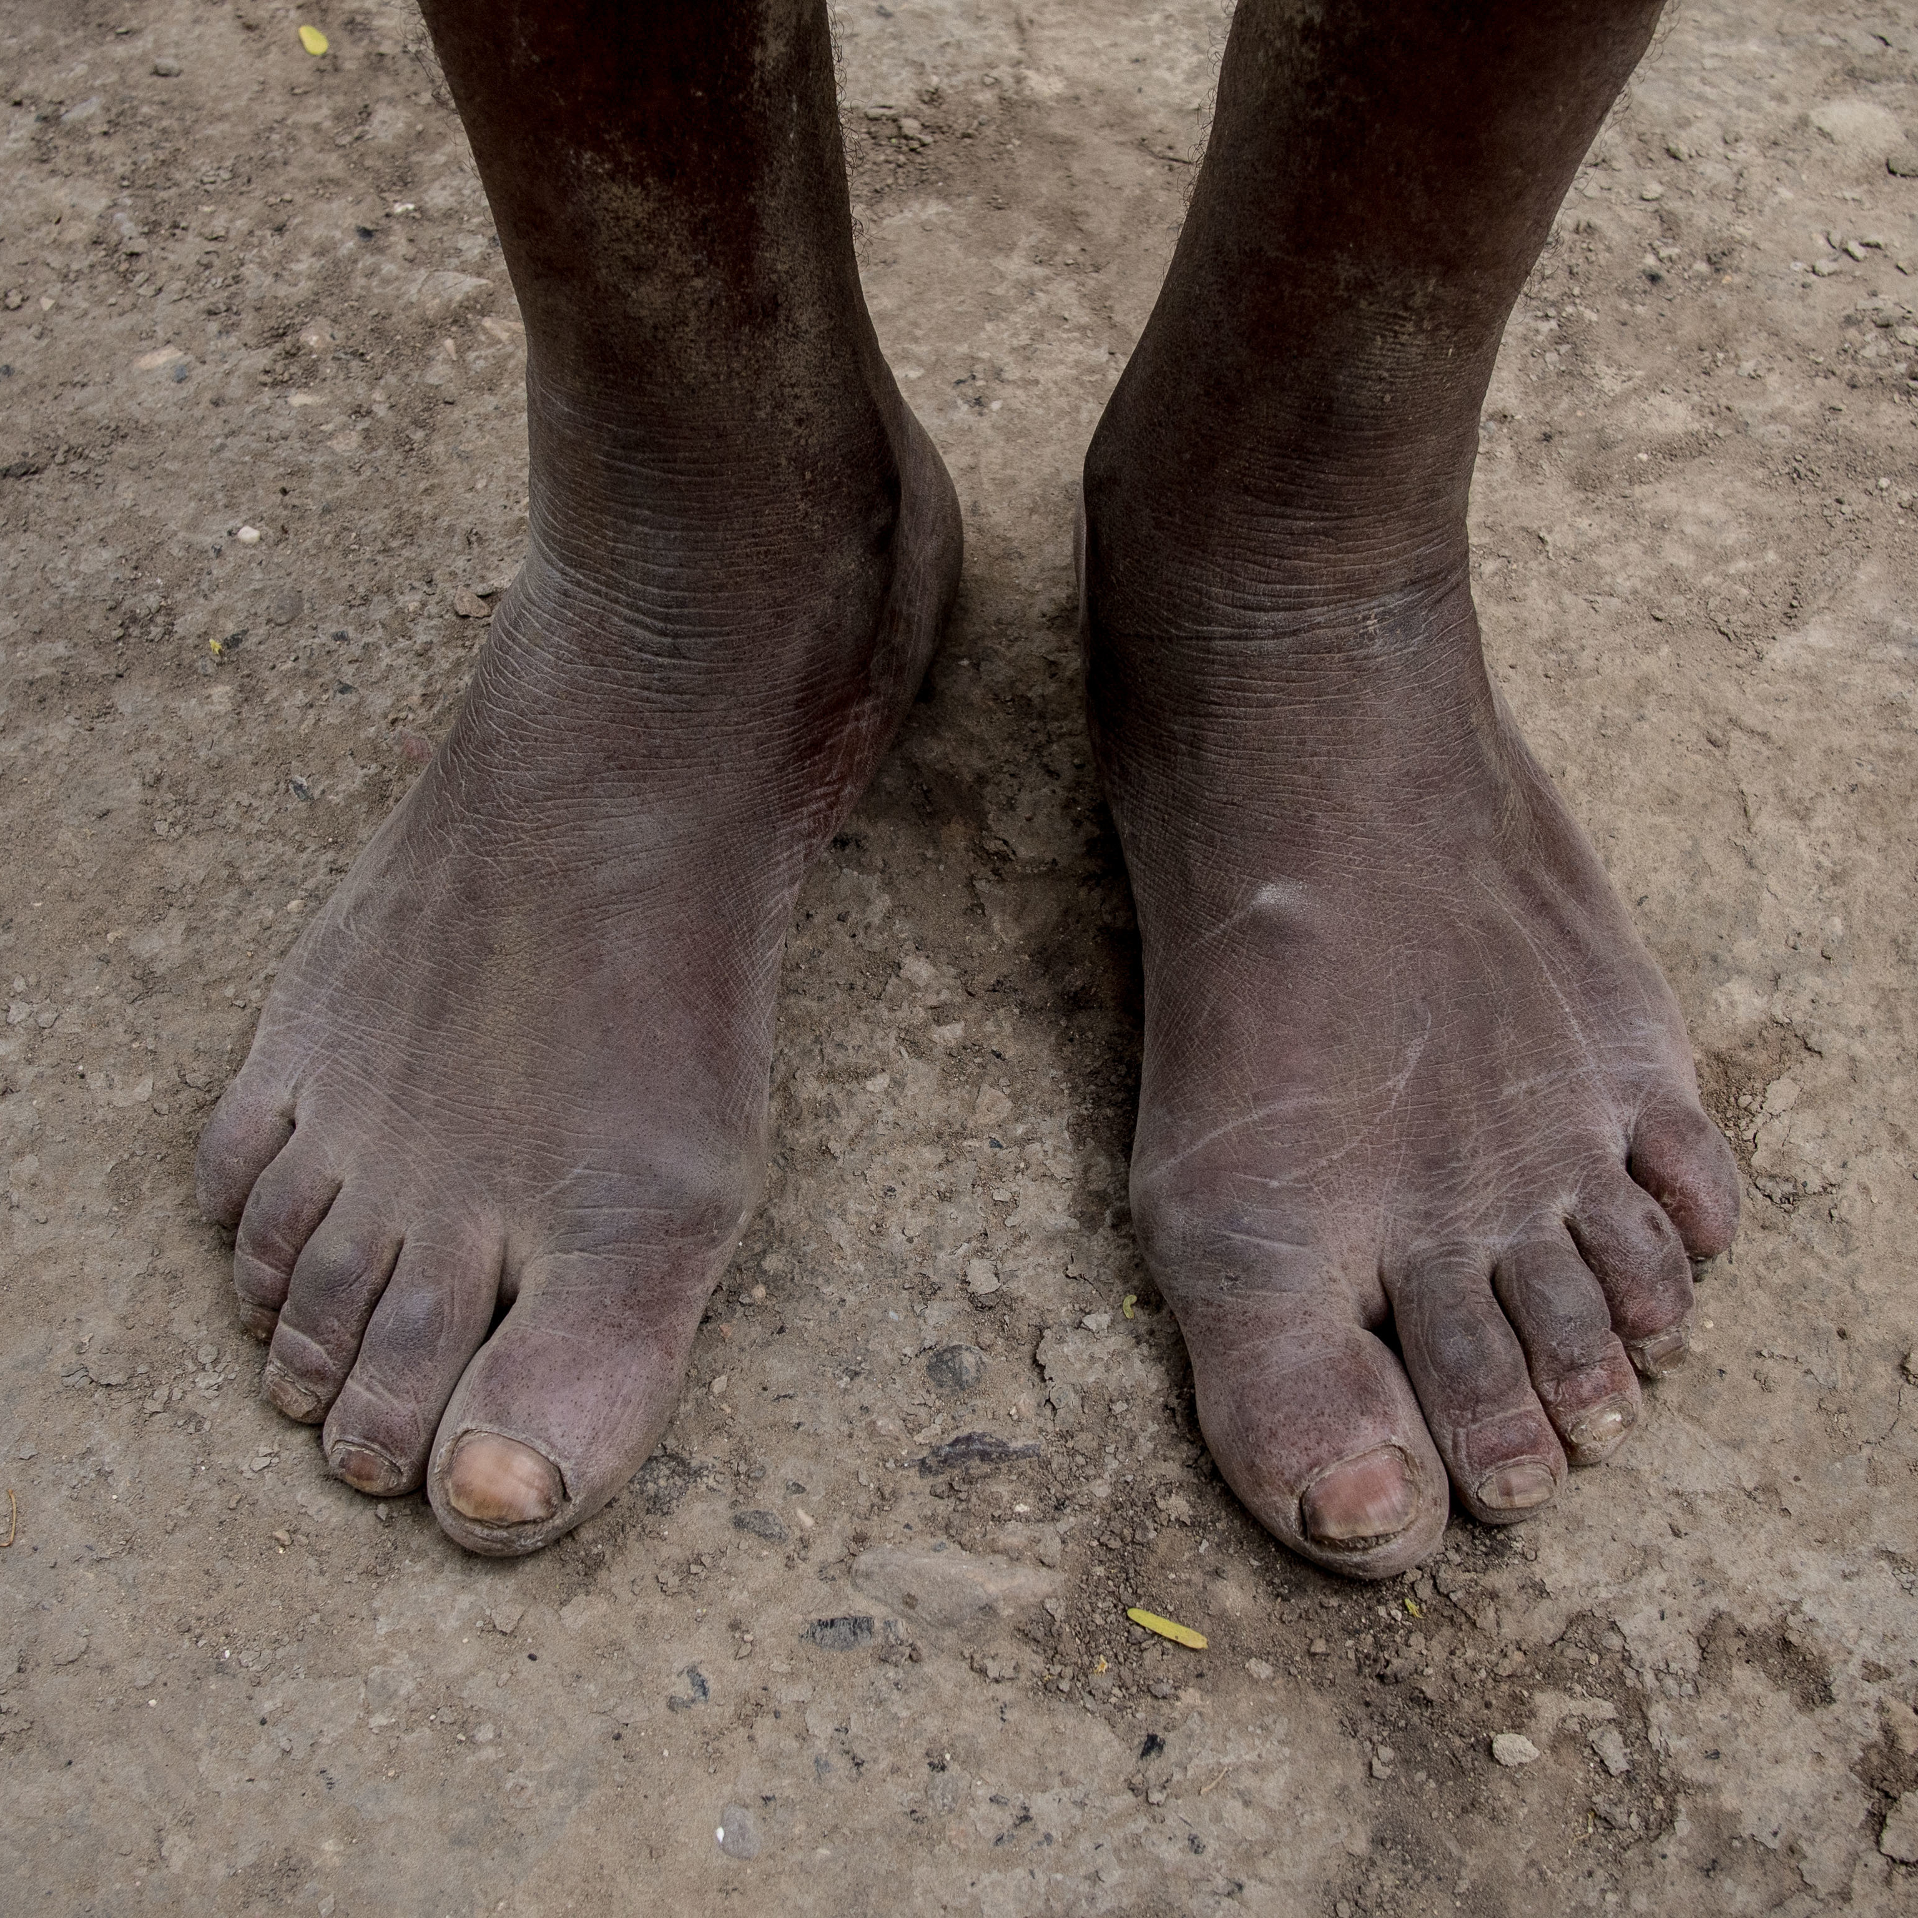
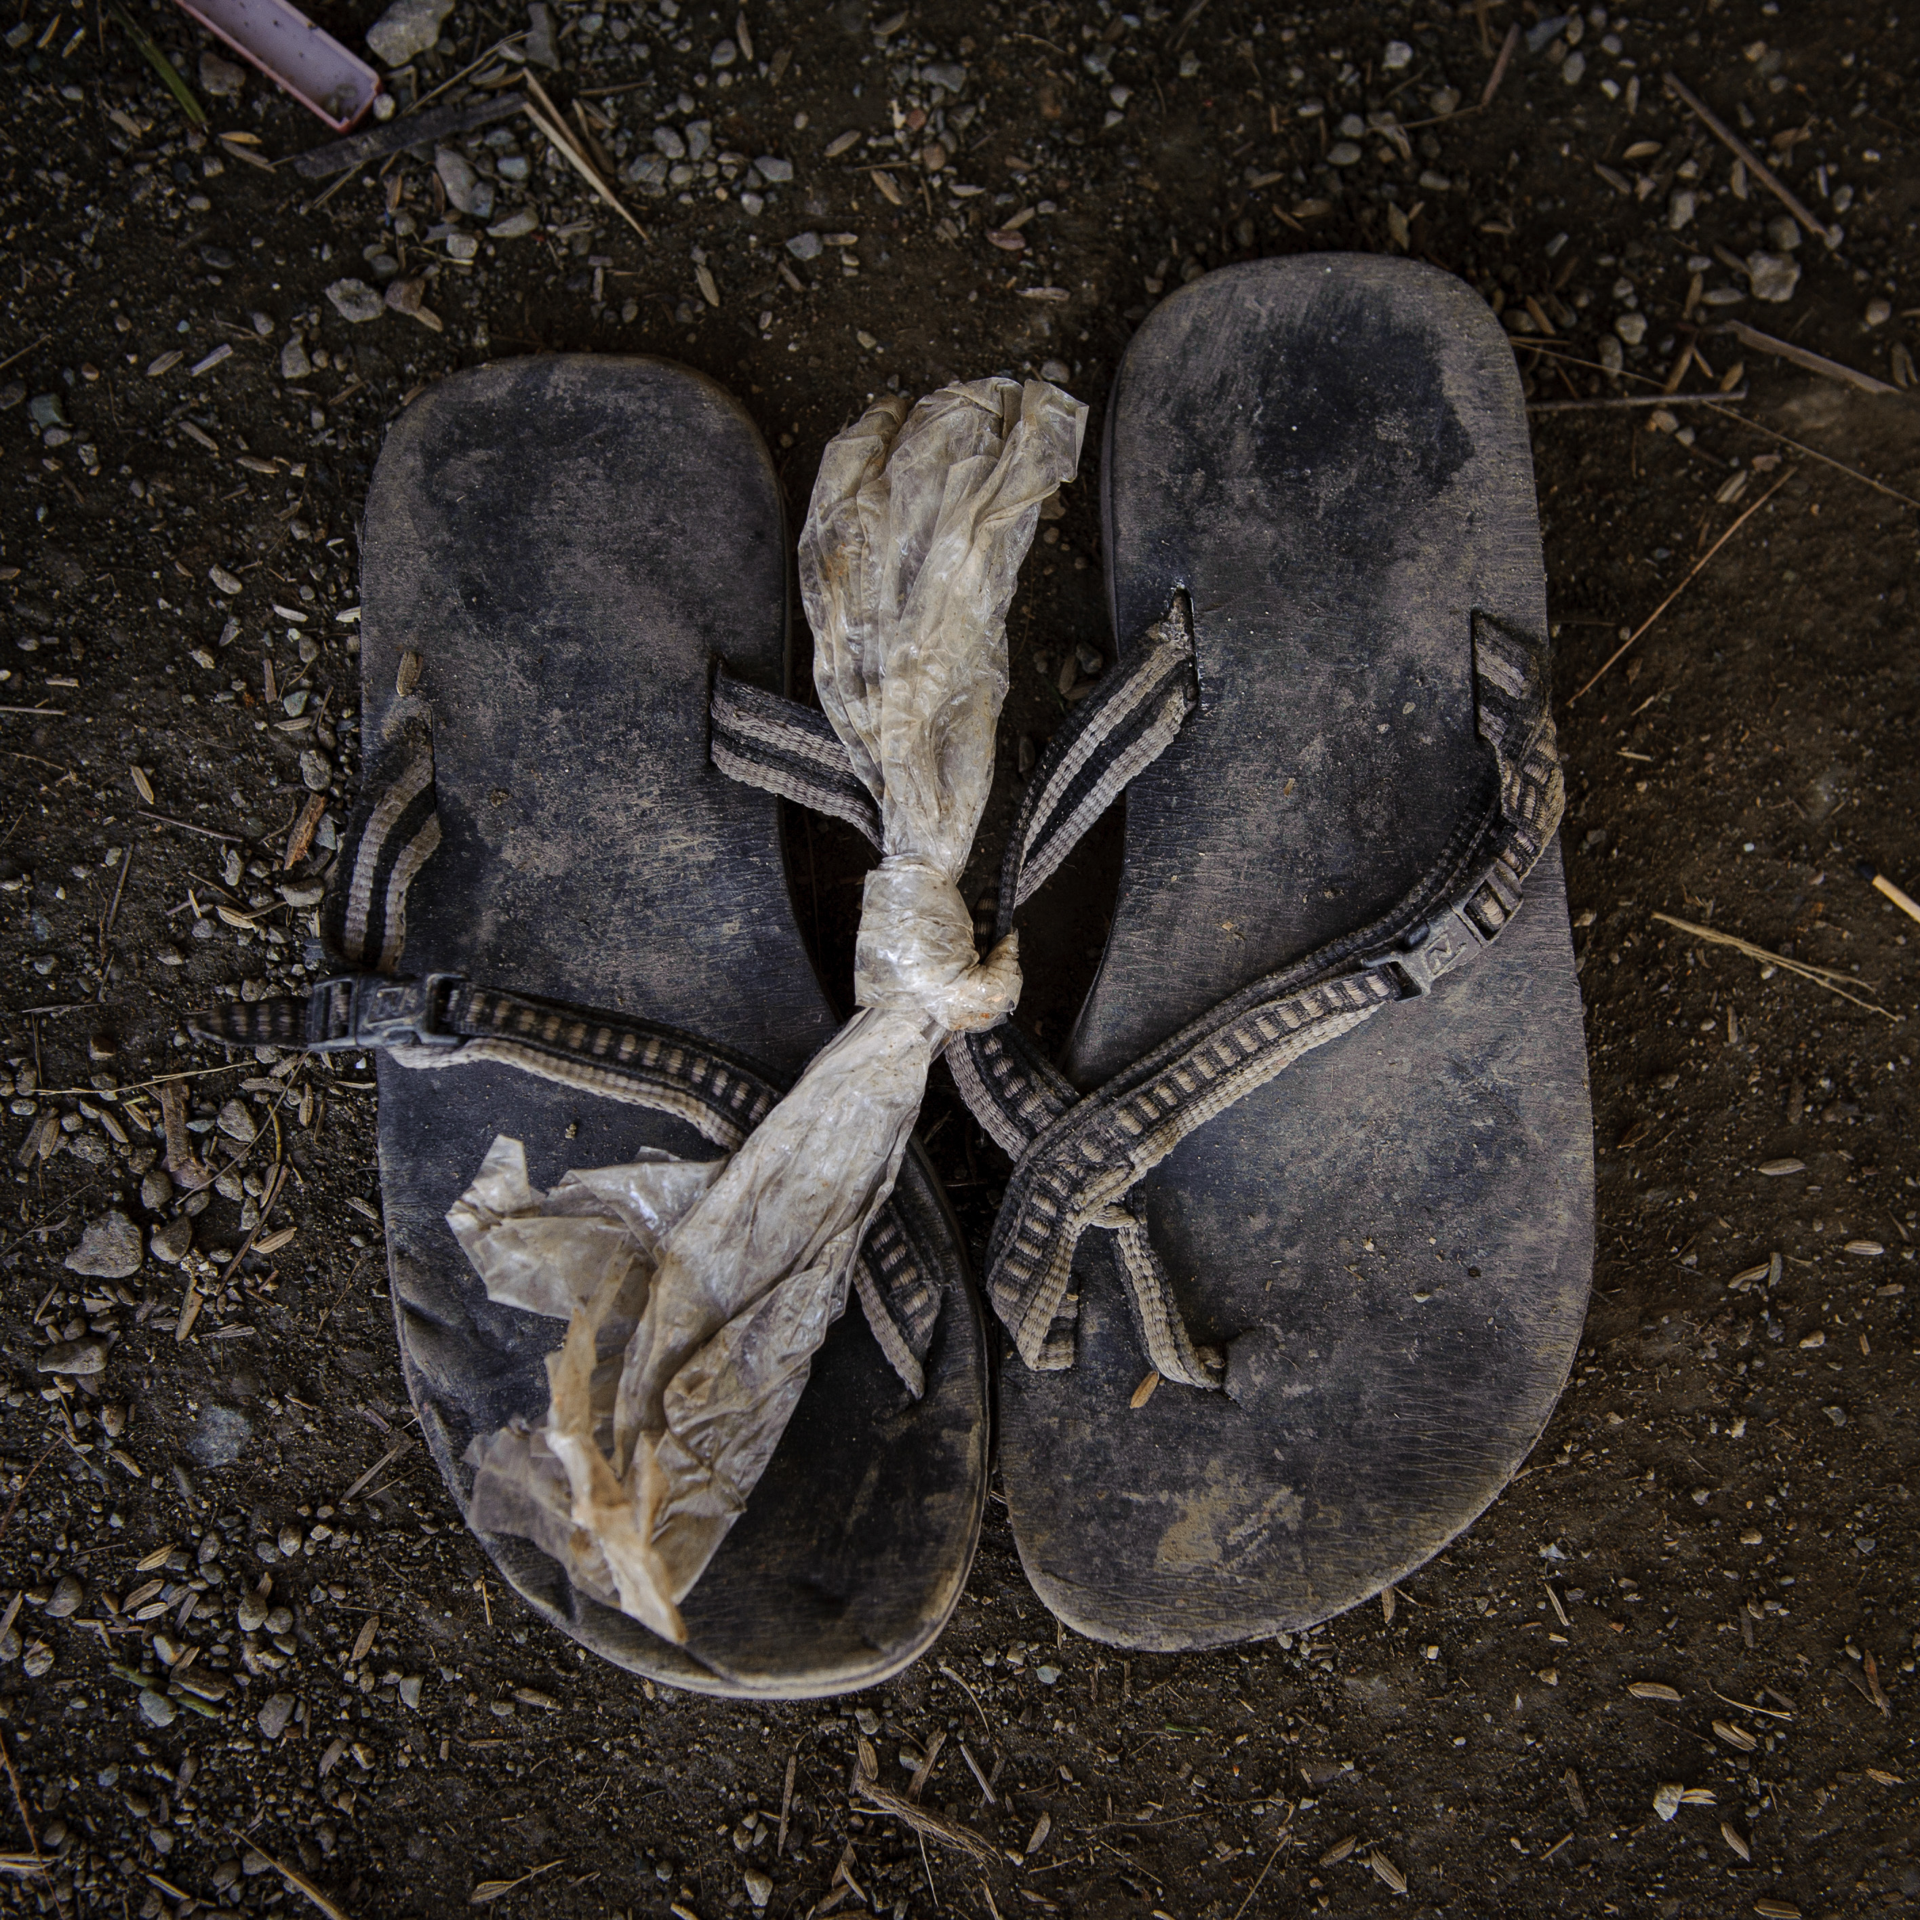
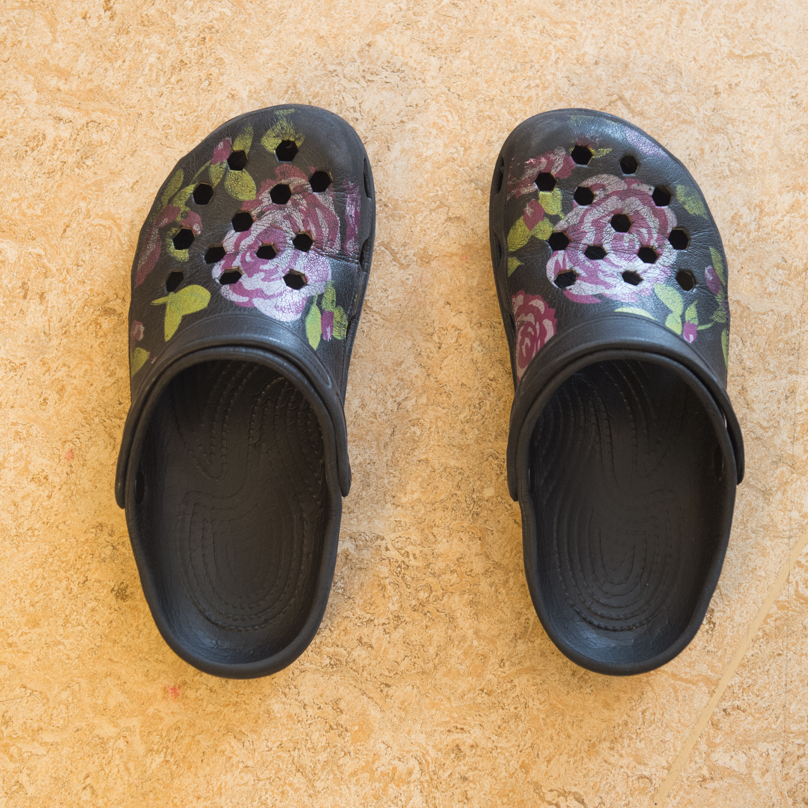
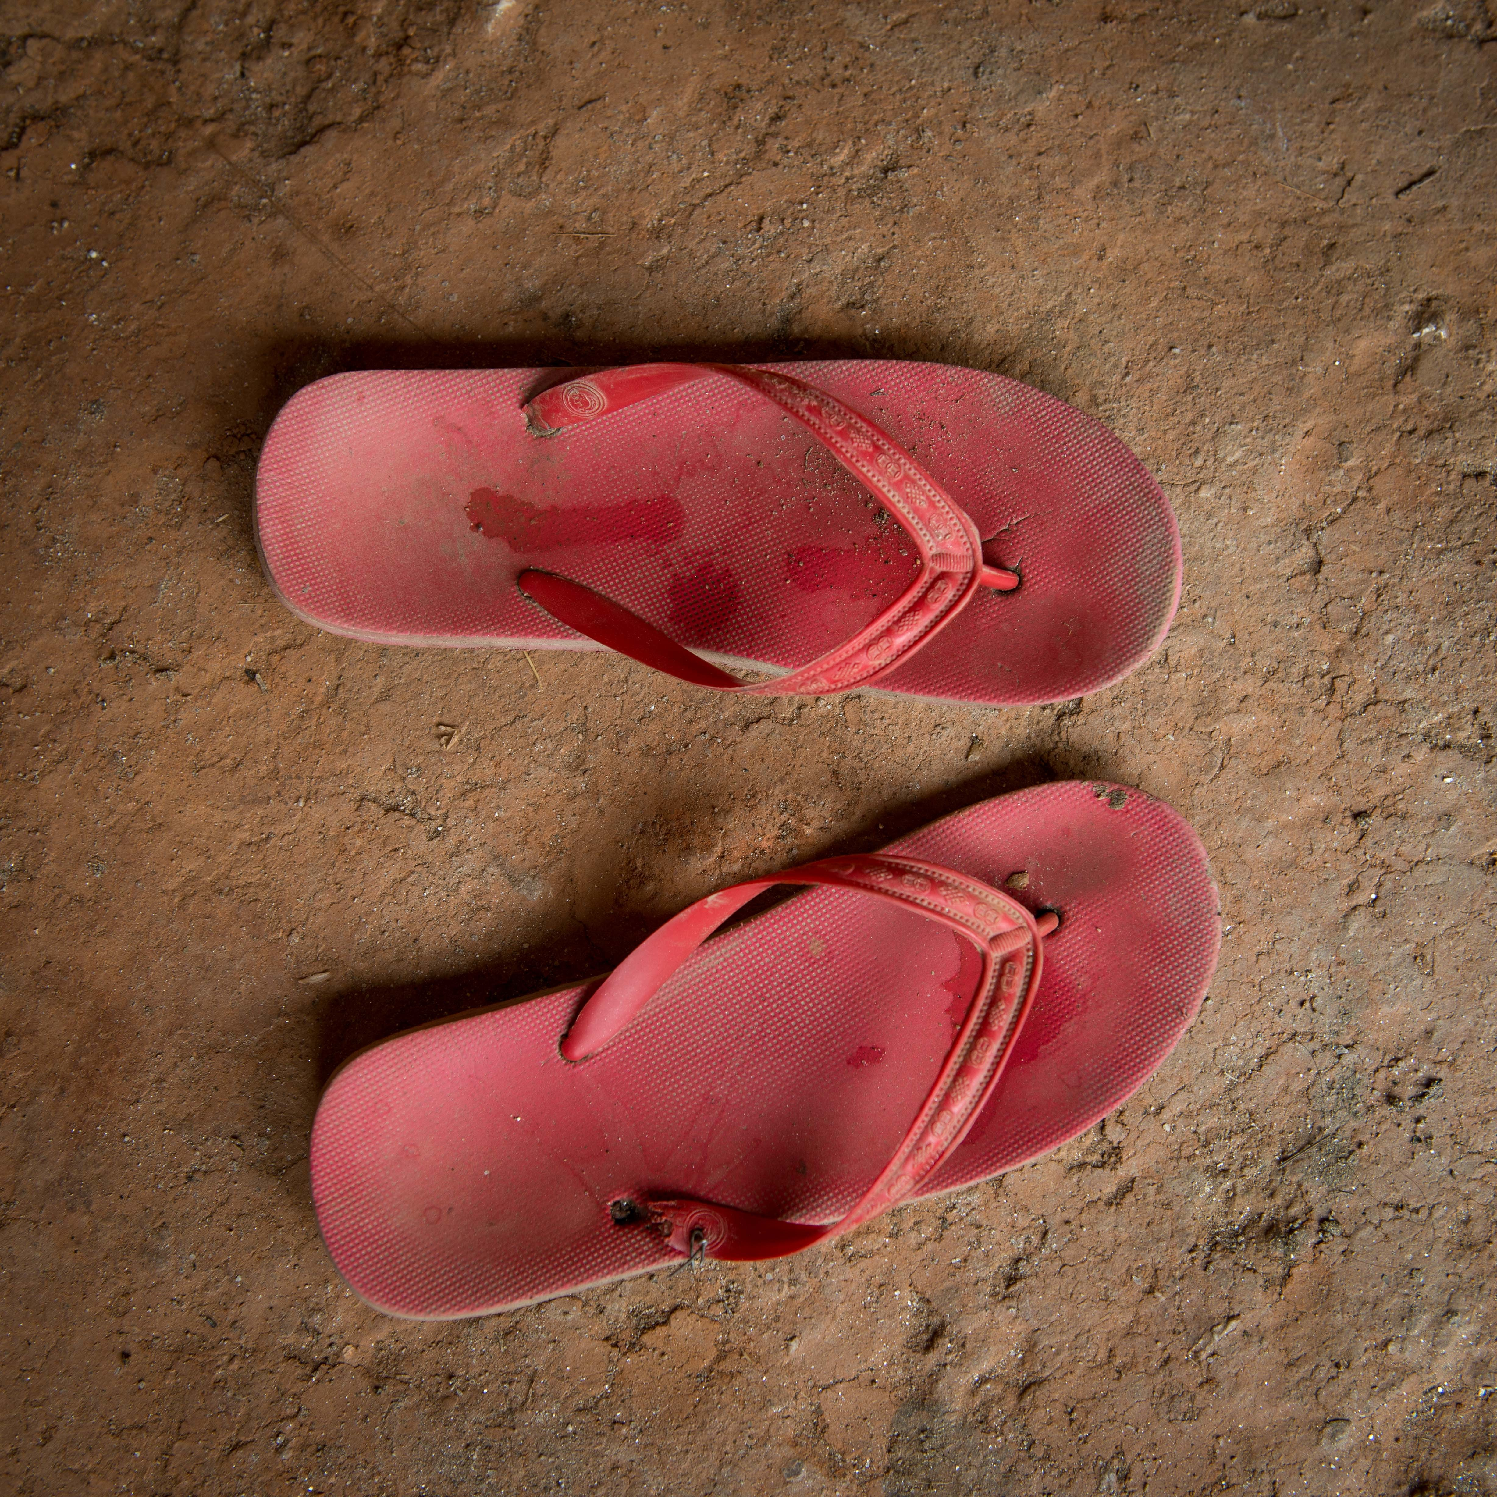
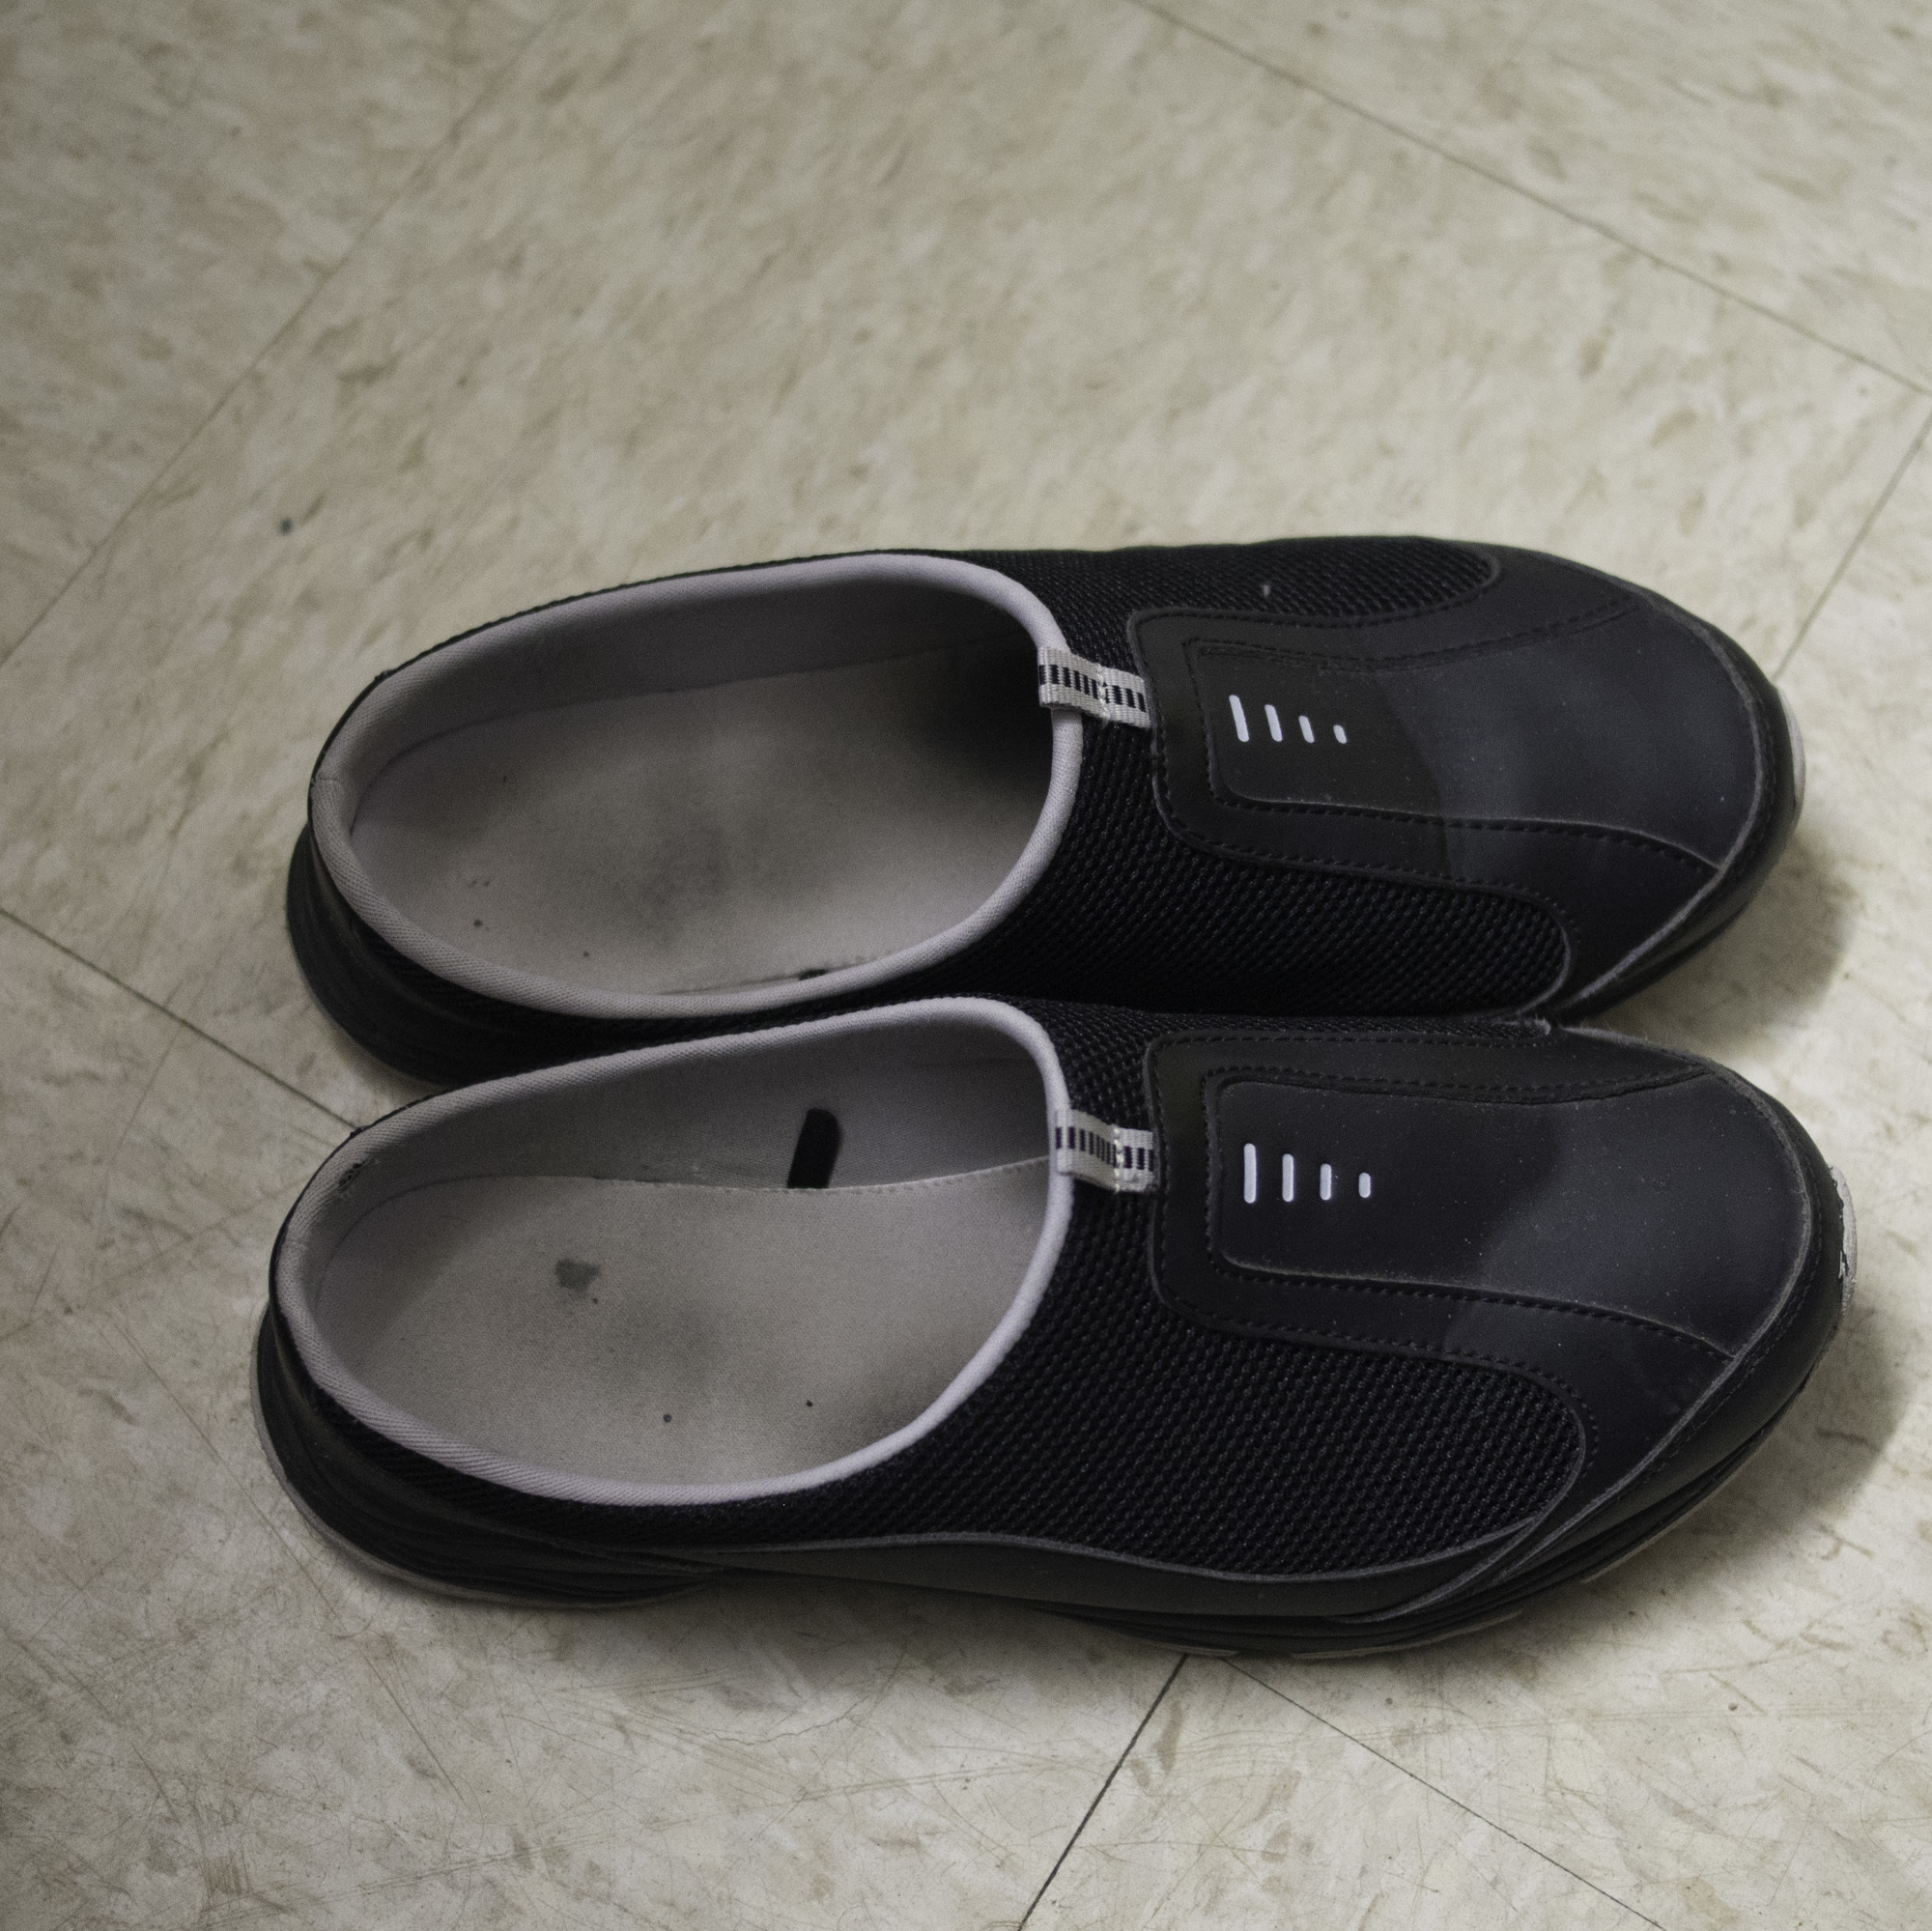
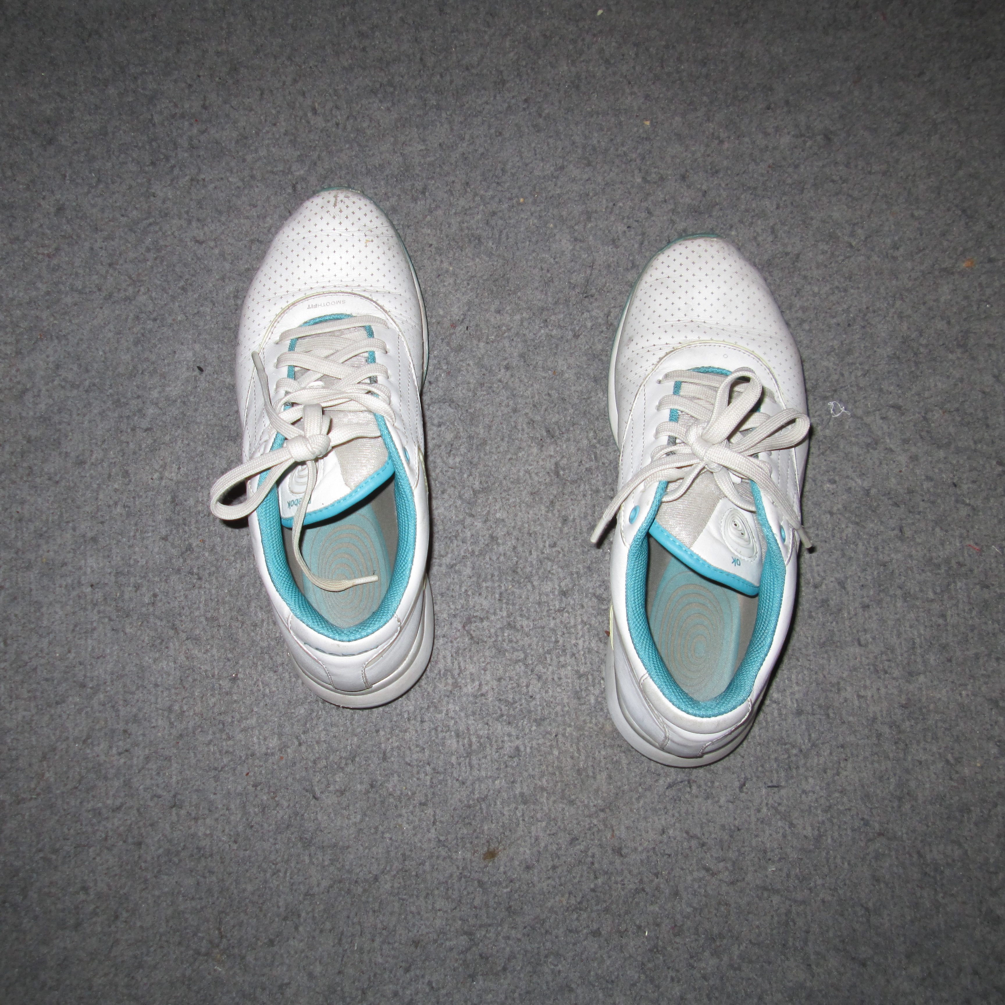
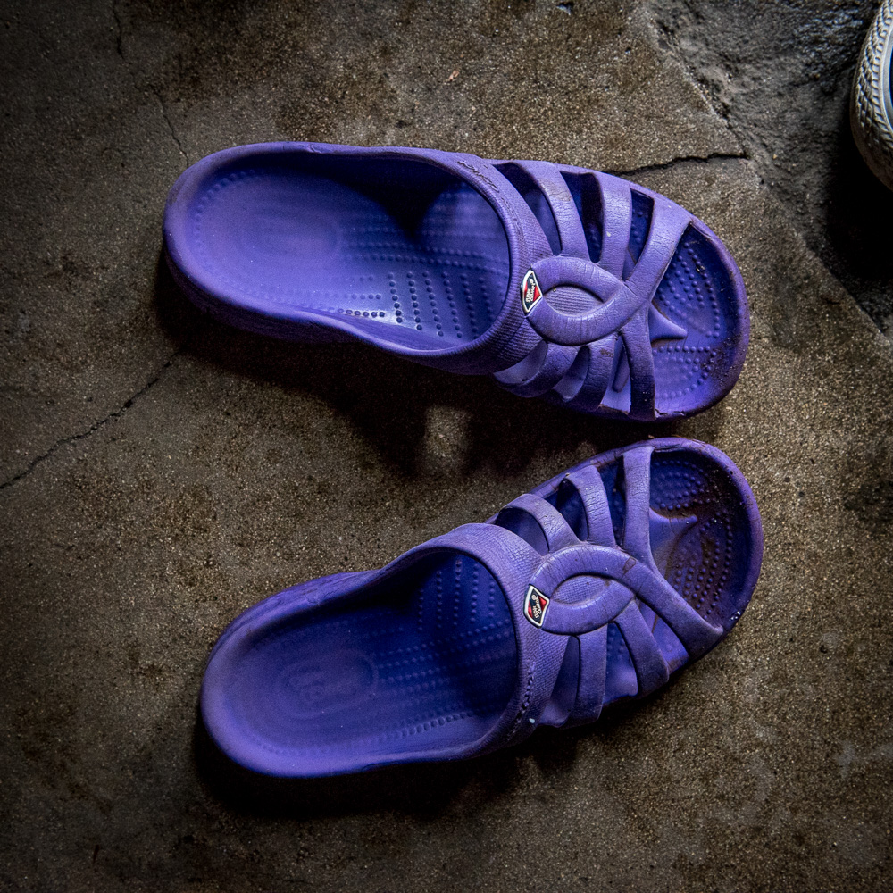
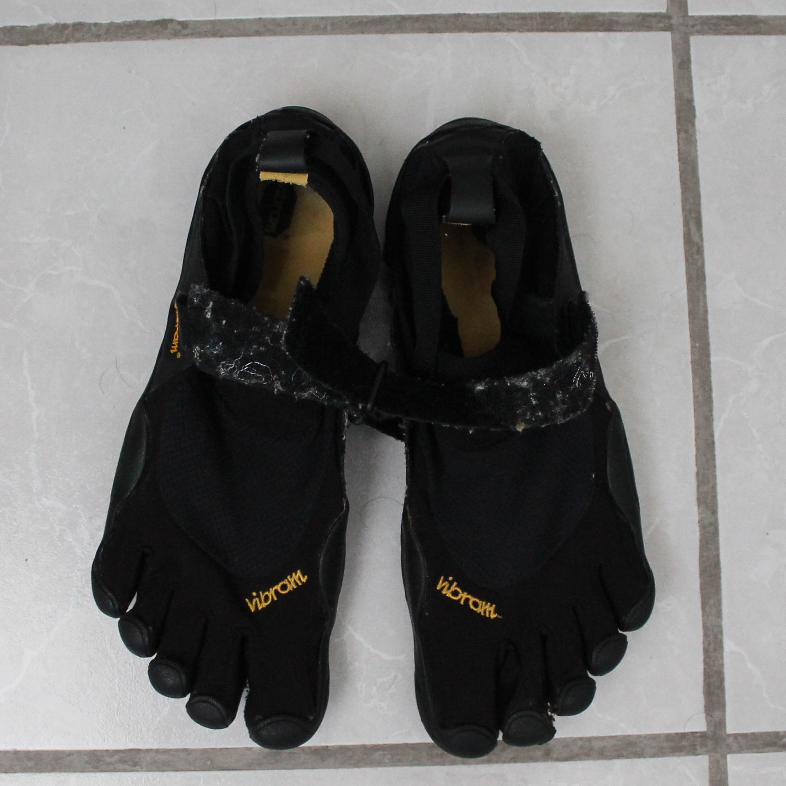
“
If you have a fact based view of the world today, you have a chance of understanding what comes next.
- Ola Rosling

Slide 6
“
If you have a fact based view of the world today, you have a chance of understanding what comes next.
- Ola Rosling

Slide 7
“
If you have a fact based view of the world today, you have a chance of understanding what comes next.
- Hans Rosling

Slide 8
“
If you have a fact based view of the world today, you have a chance of understanding what comes next.
- Hans Rosling

Slide 9
“
If you have a fact based view of the world today, you have a chance of understanding what comes next.
”
- Ola Rosling

Slide 10
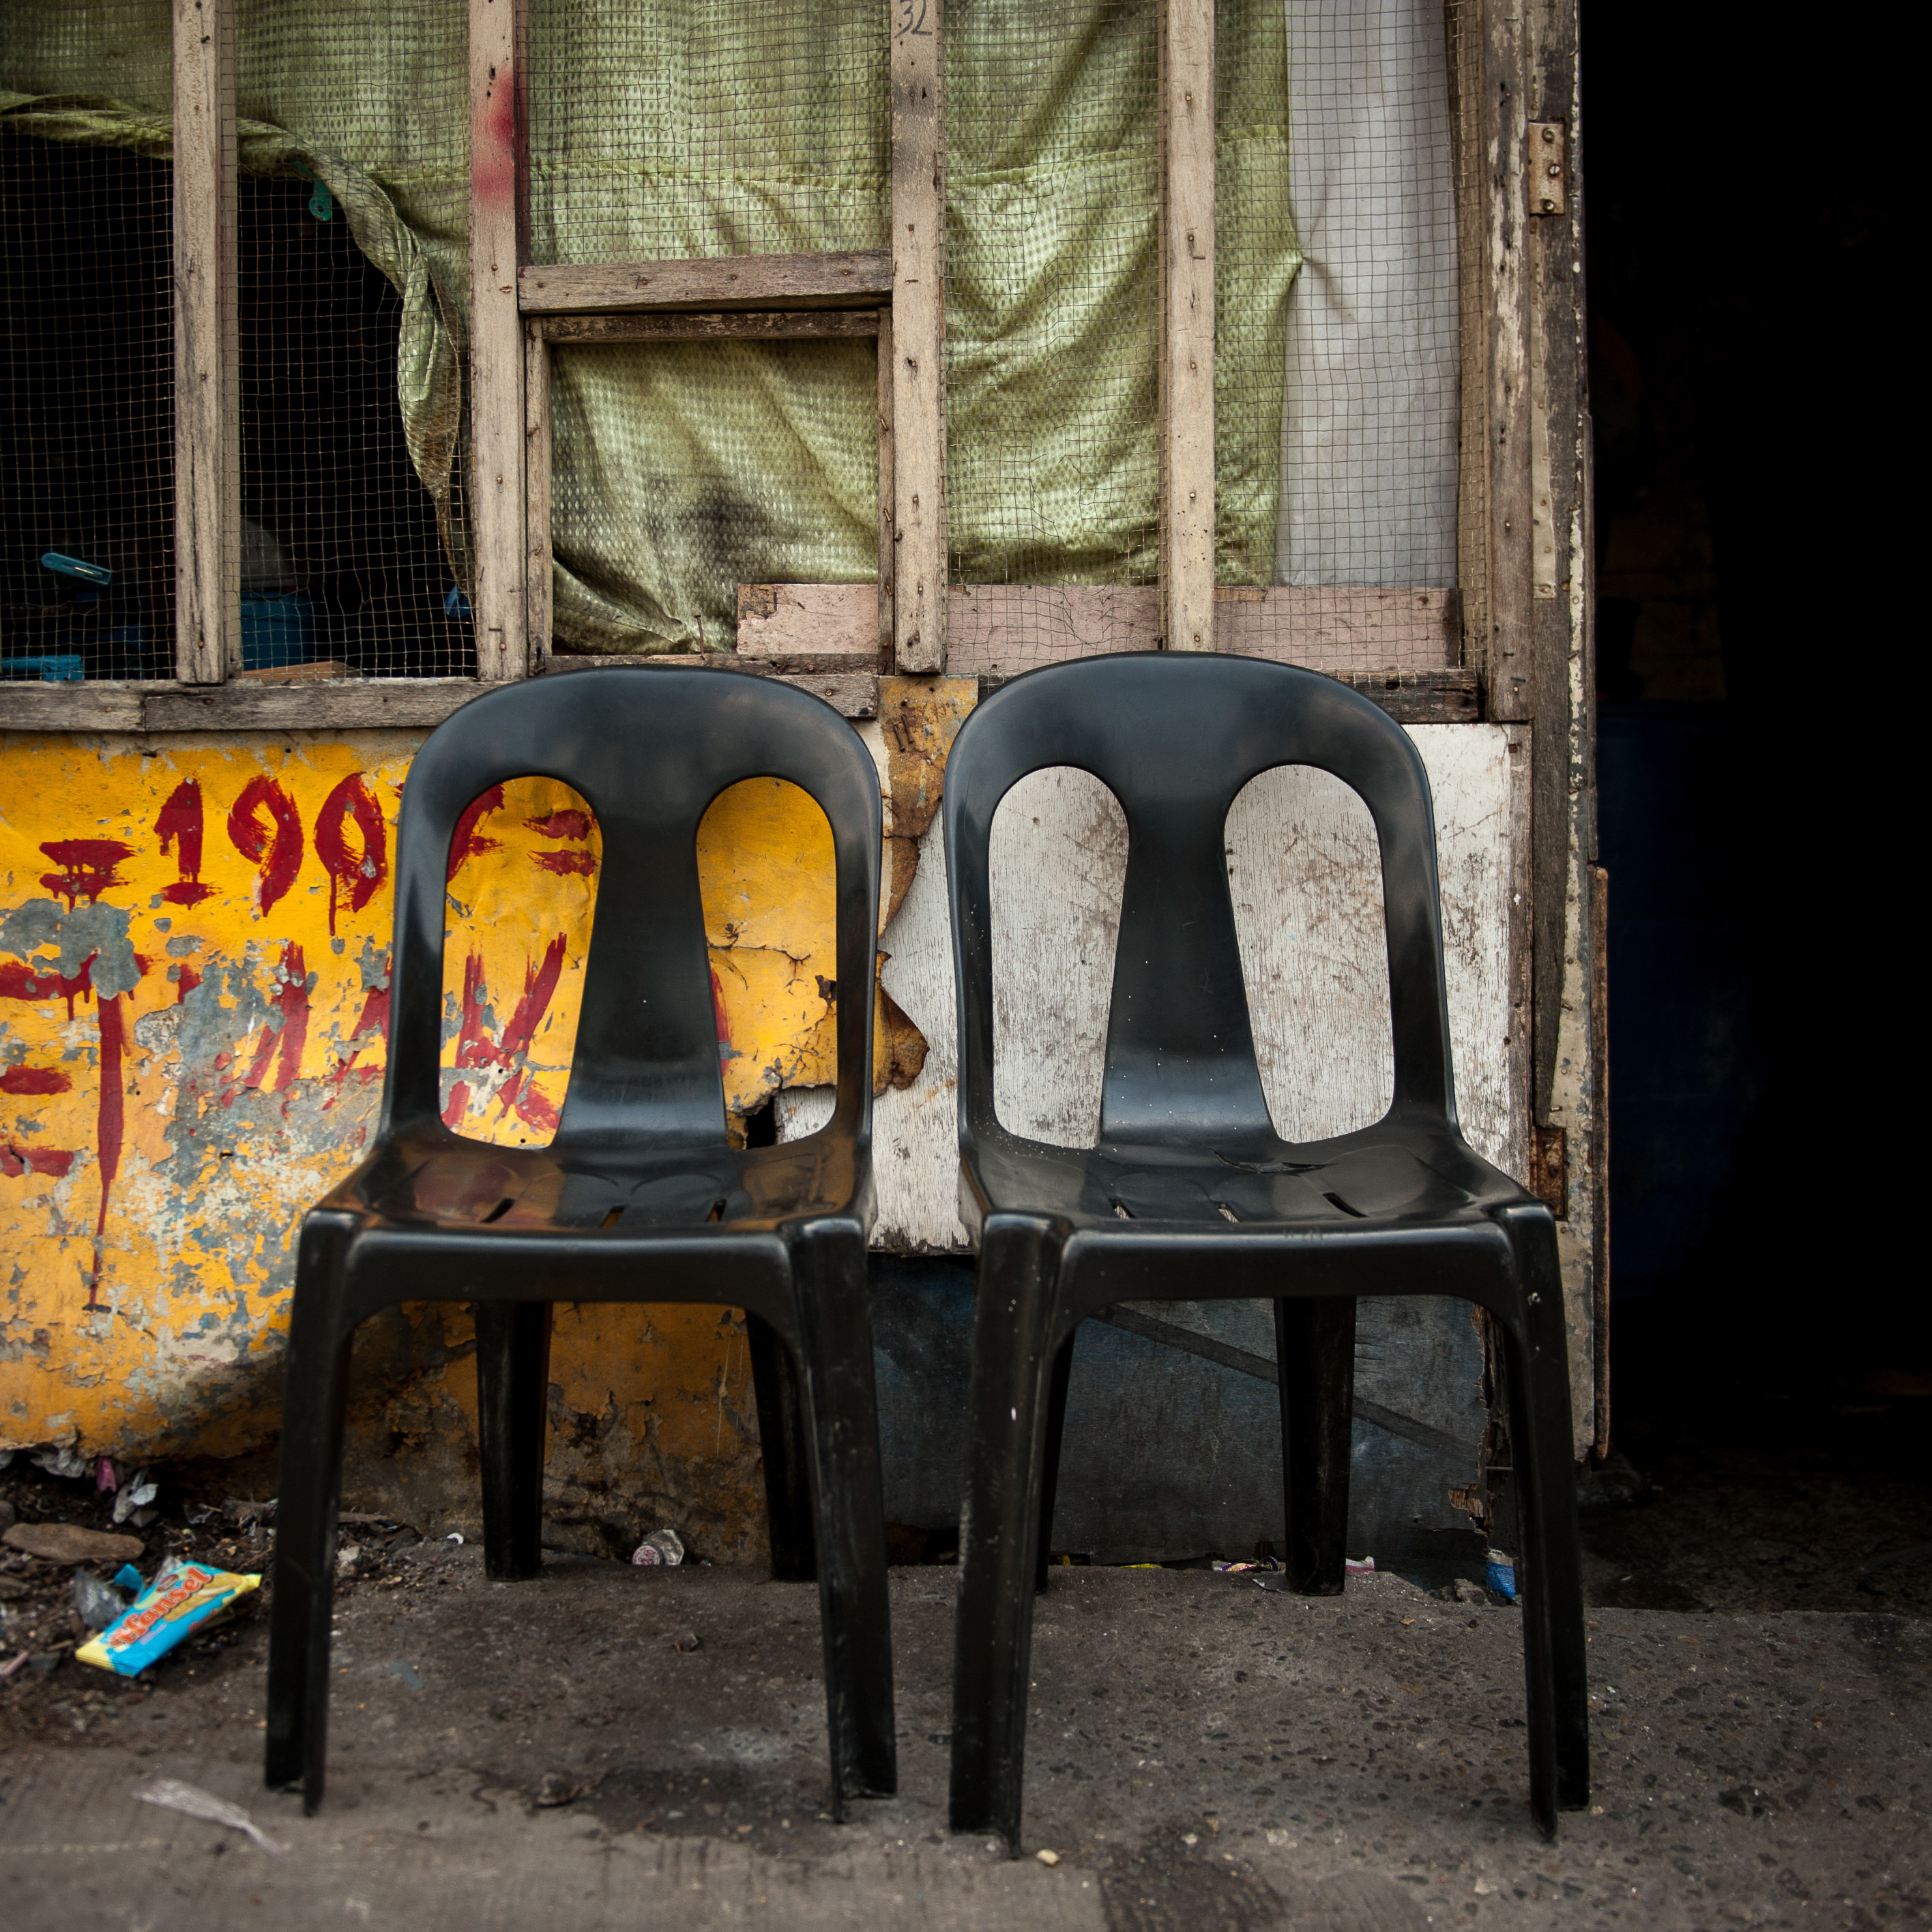
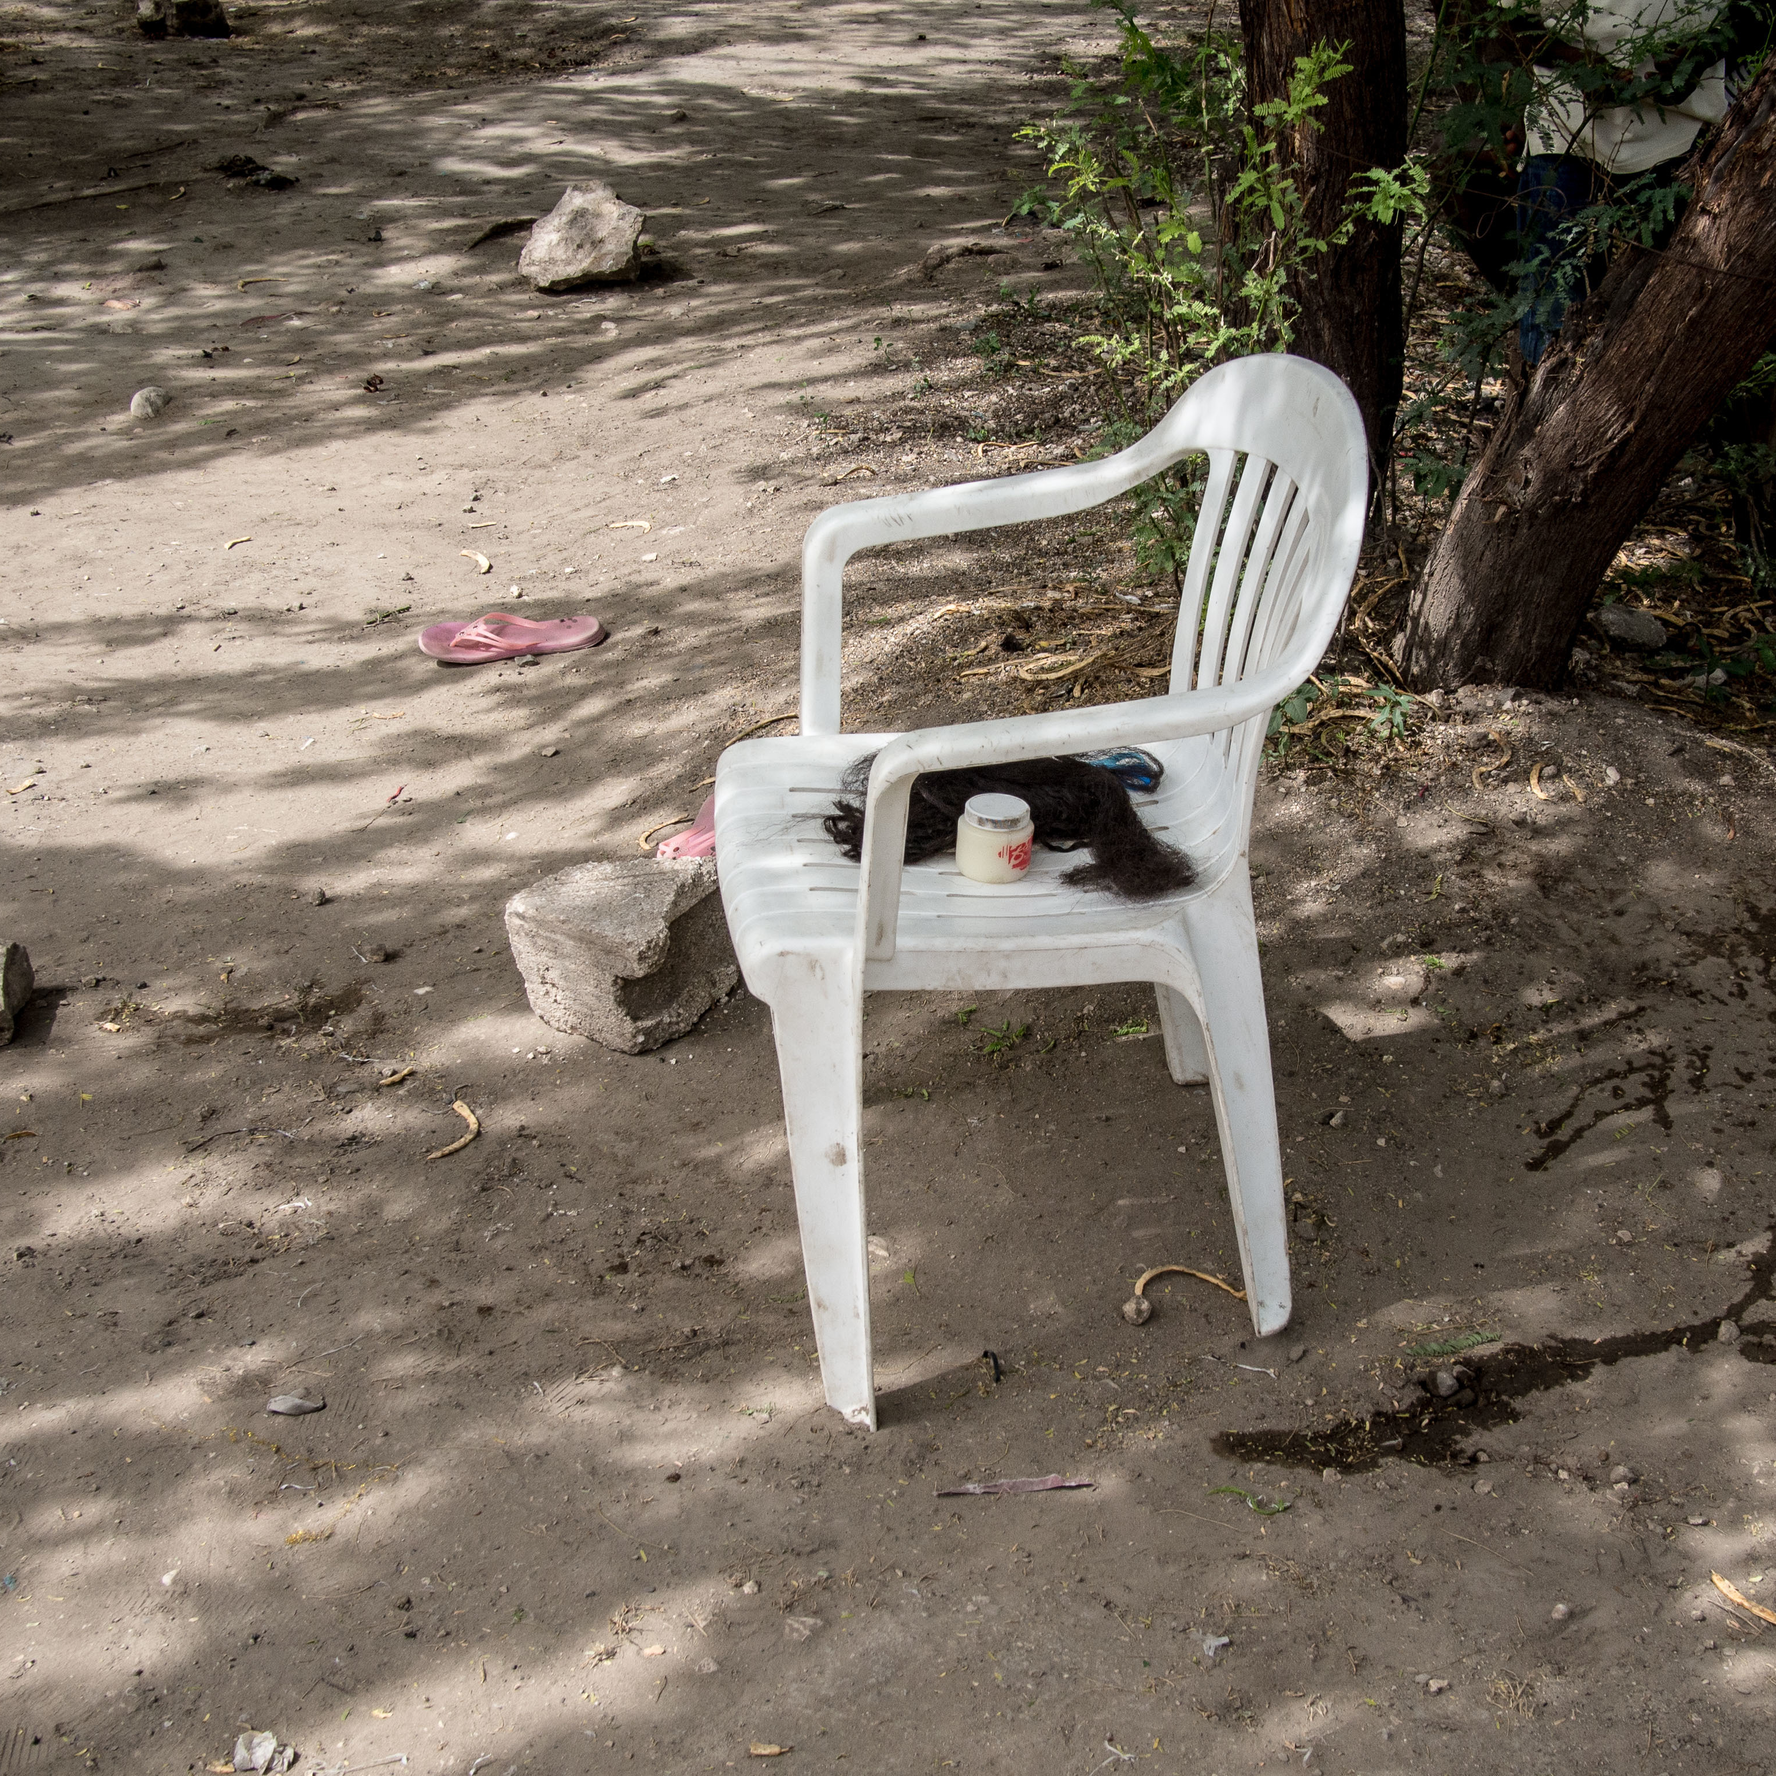
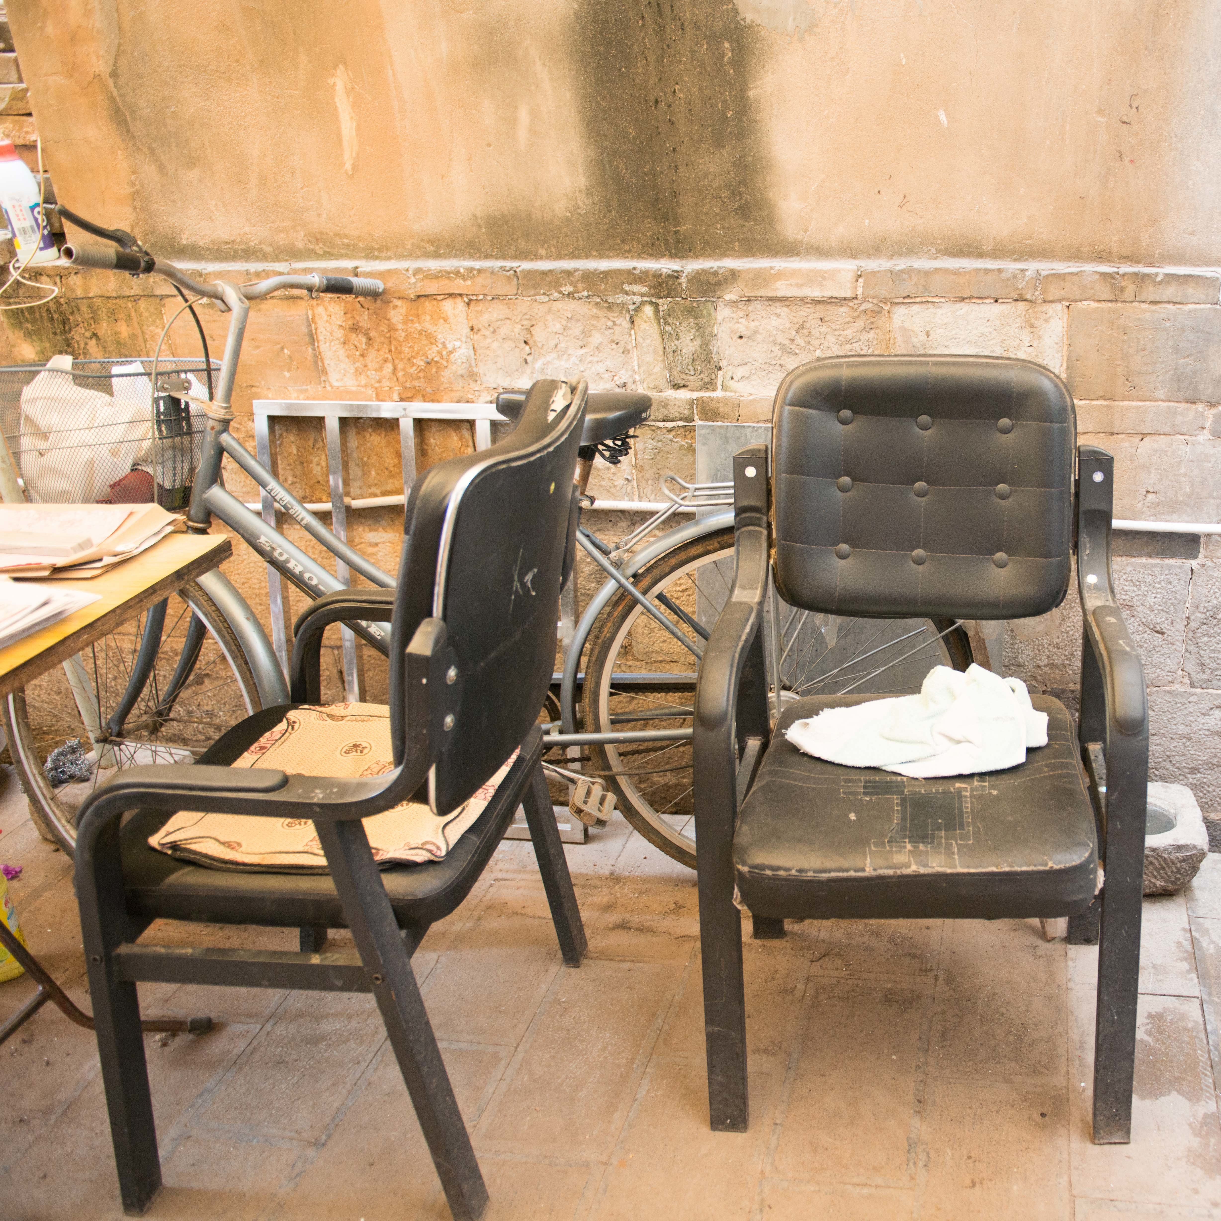
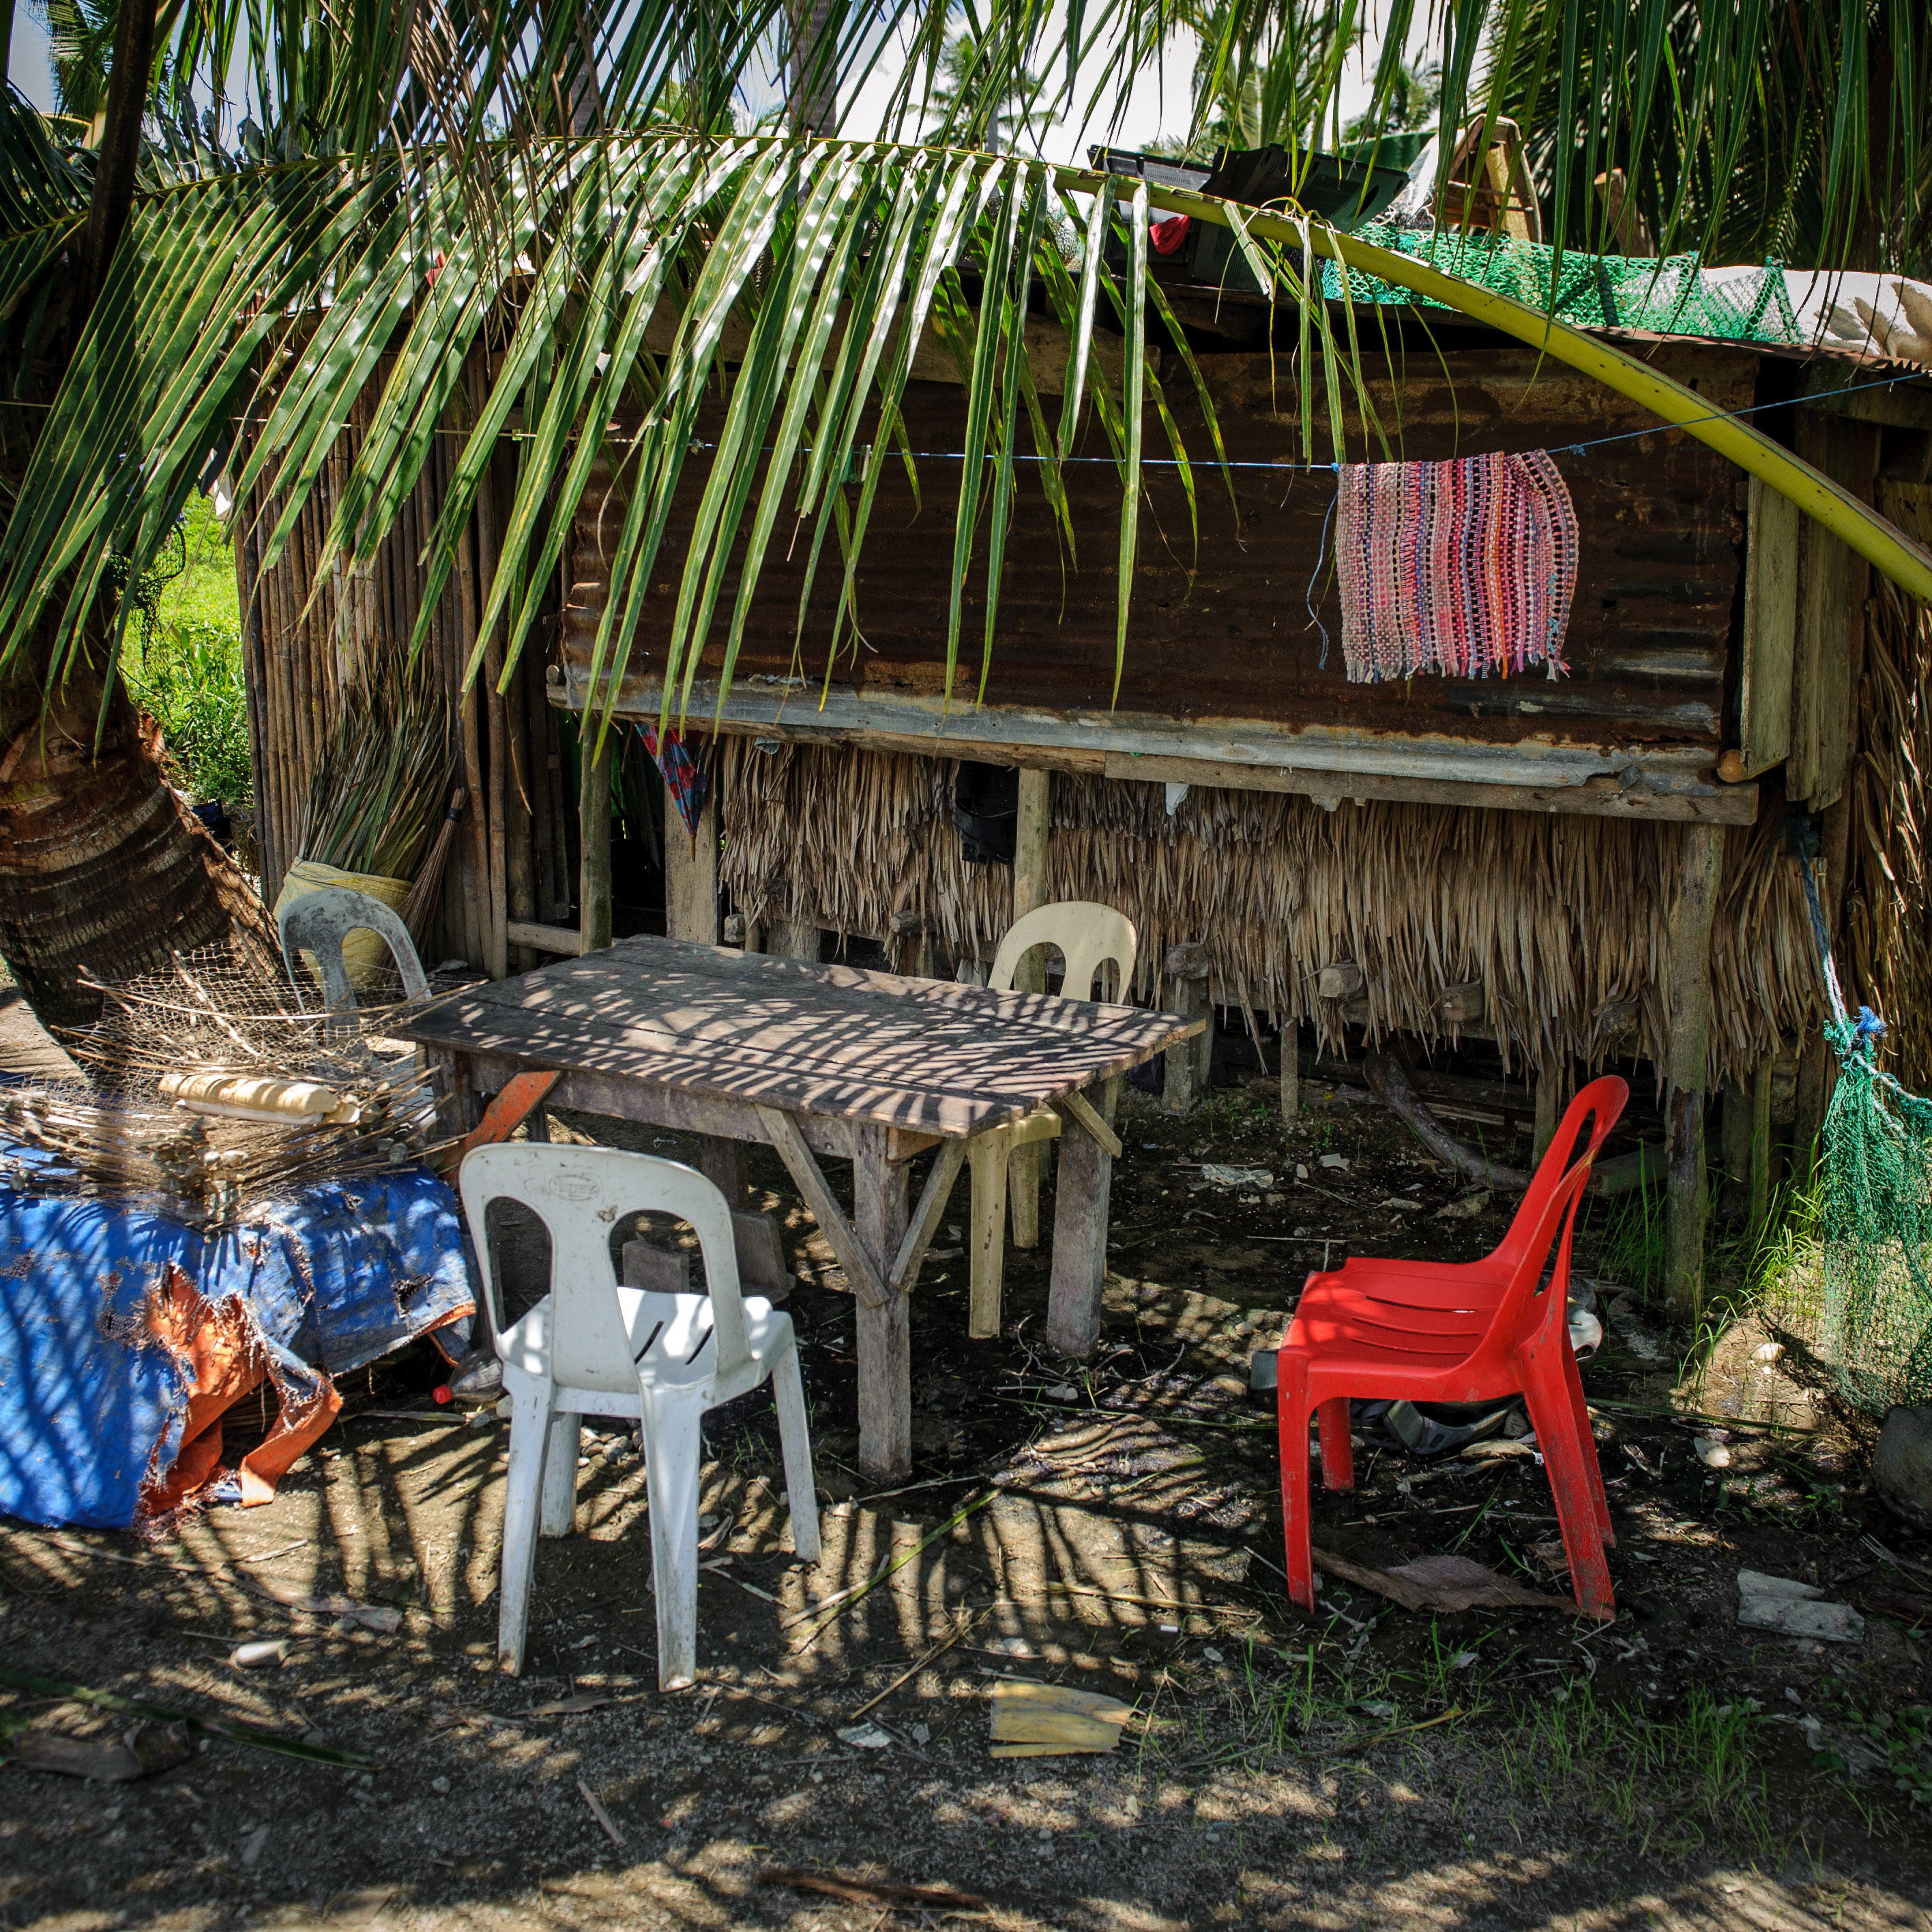
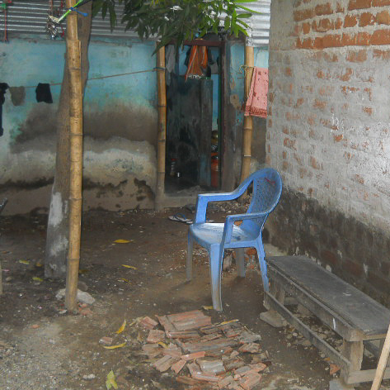
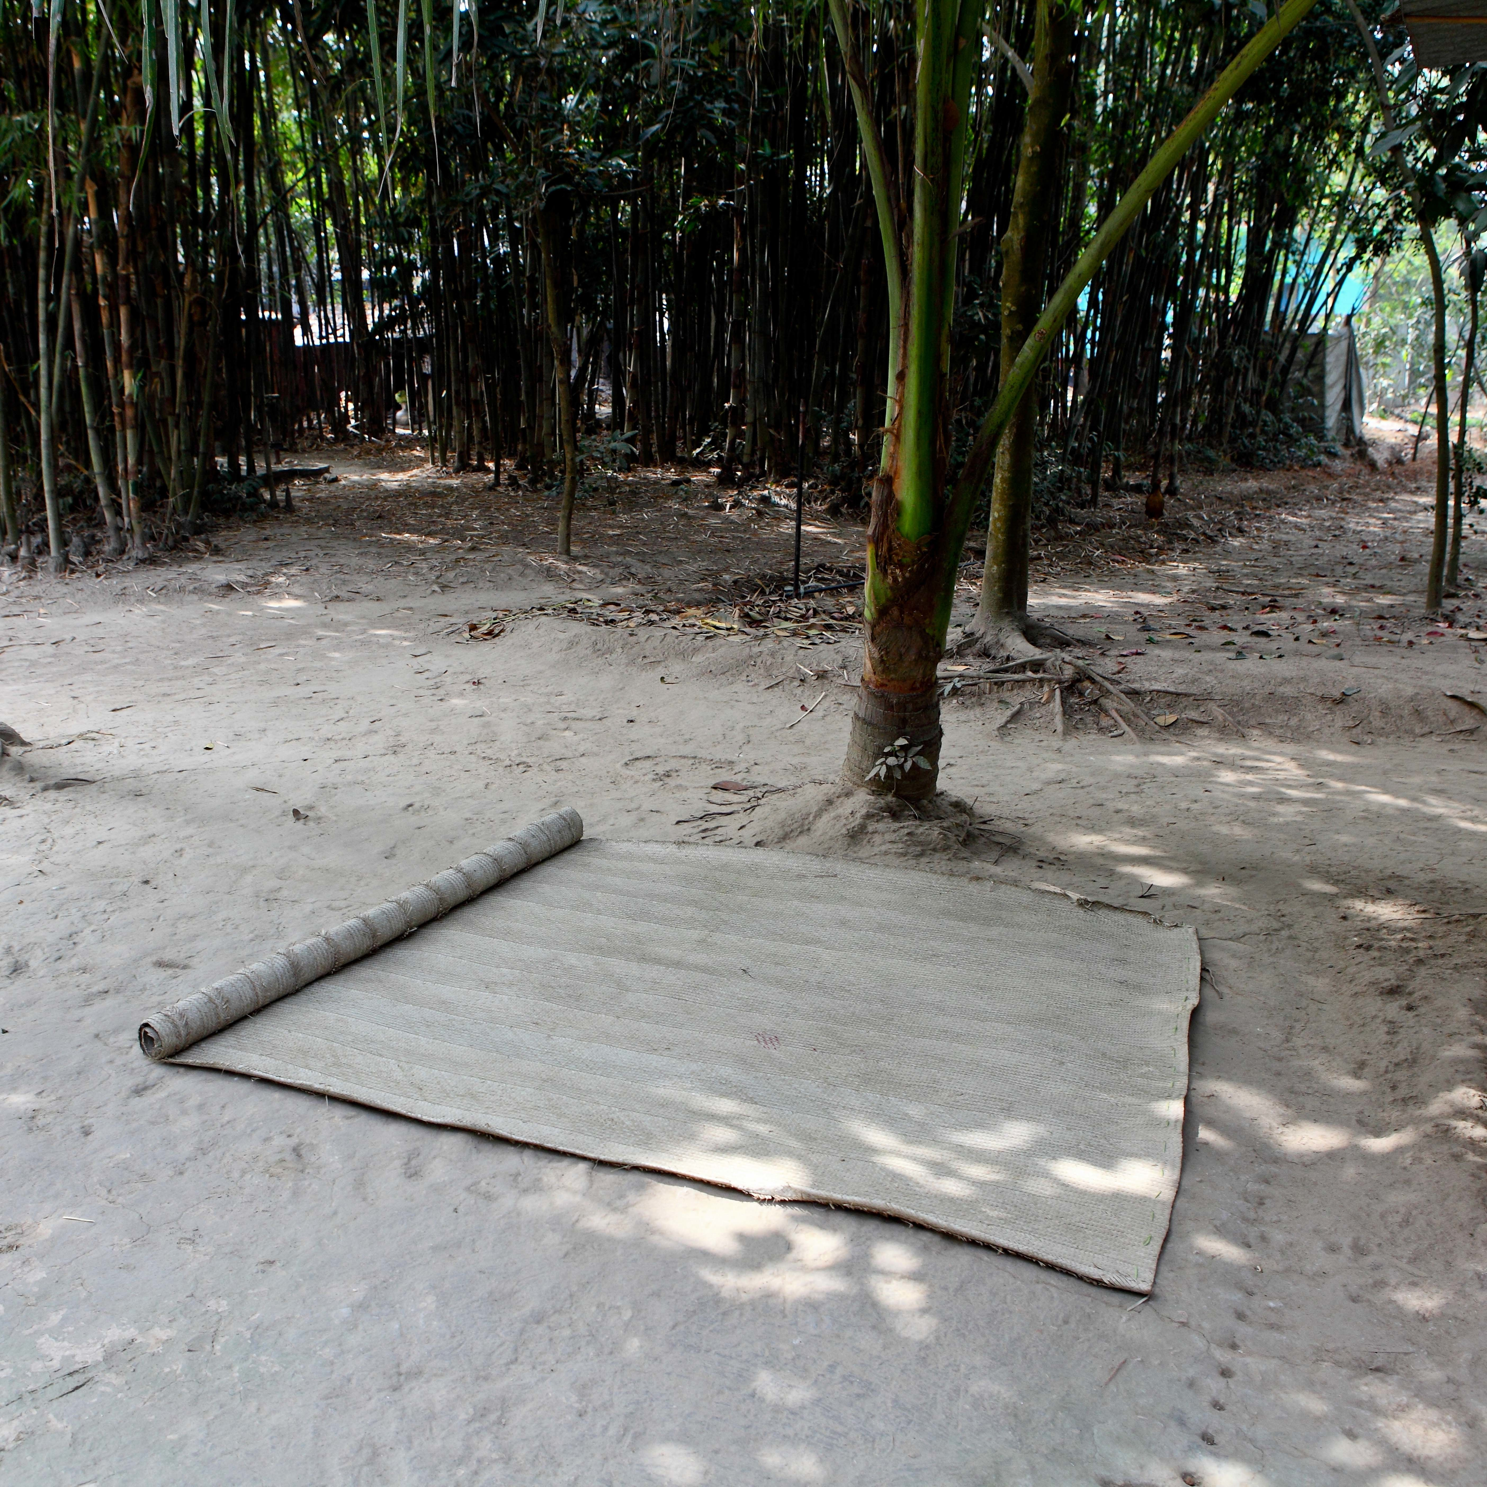
“
Using photos as data lets you see the reality behind the numbers.
- Anna Rosling Rönnlund

Slide 11
“
Using photos as data lets you see the reality behind the numbers.
- Anna Rosling Rönnlund

Slide 12
“
Using photos as data lets you see the reality behind the numbers.
- Anna Rosling Rönnlund

Slide 13
“
Using photos as data lets you see the reality behind the numbers.
- Anna Rosling Rönnlund

